Slide 1

ORIGINATOR: Mitch Bivens
EDITED BY: JBF - NFPA 8/8/24
2024-25 Season

Slide 2
Index of sections:
(4) Safety considerations
(5 - 8) Construction tips: using wood glue, using the miter box and hand saw to cut wood, using the hand drill to drill a hole in a syringe
(9-11) Making a (4” – 100mm) cube
(12) Lifter
(13) Rotating Platform
(14) Documents checklist to refer to during presentation
(15 -23) Maximise Portfolio points:
  (17-20) Strong & Stable Structure
  (21-22) Placement of Fluid Power systems
  (23) Iso-Ortho views illustrated
  (24) Portfolio Template and Checklist
(25) Team work and work habits
(26-28) The Challenge and its process
(29 -30) Using the piston-syringe clips
(31 – 33) Base block and 4” Squares
(34) Safety Review
(35 - 36) Using sample resources
(37 – 41) Sketching and organizing your time
2

Slide 3
Please fill out the Pre-Survey to the best of your ability
Your name is not required!
Video link:
http://www.tpt.org/Fluid-Power:-A-Force-for-Change/
3

Slide 4
Safety
Safety is everyone’s responsibility!
Always wear safety glasses - even when not cutting or drilling
No Running, No Throwing, No Horse Play!
When sawing, drilling, filing or sanding;
  Ensure a mitre box securely clamped down
  Ensure each workpiece is secure & stable
  Ensure your hands/fingers are out of harms way
  Wipe sawdust, don’t blow
If you use the low-temp glue gun remember the tip is HOT & can burn
Questions?
4

Slide 5
Construction Tips
Have a plan
Measure twice, cut once
Accuracy is important
Wood Glue
  Less is more!
  Excessive glue takes longer to ‘set-up’ & does NOT result in a stronger joint
  Use stick to spread out glue on contact surfaces
  Use gussets and structural members for strength
  Consider Center of Gravity of the device you make
  Know and understand how the piston-syringes are mounted
5

Slide 6
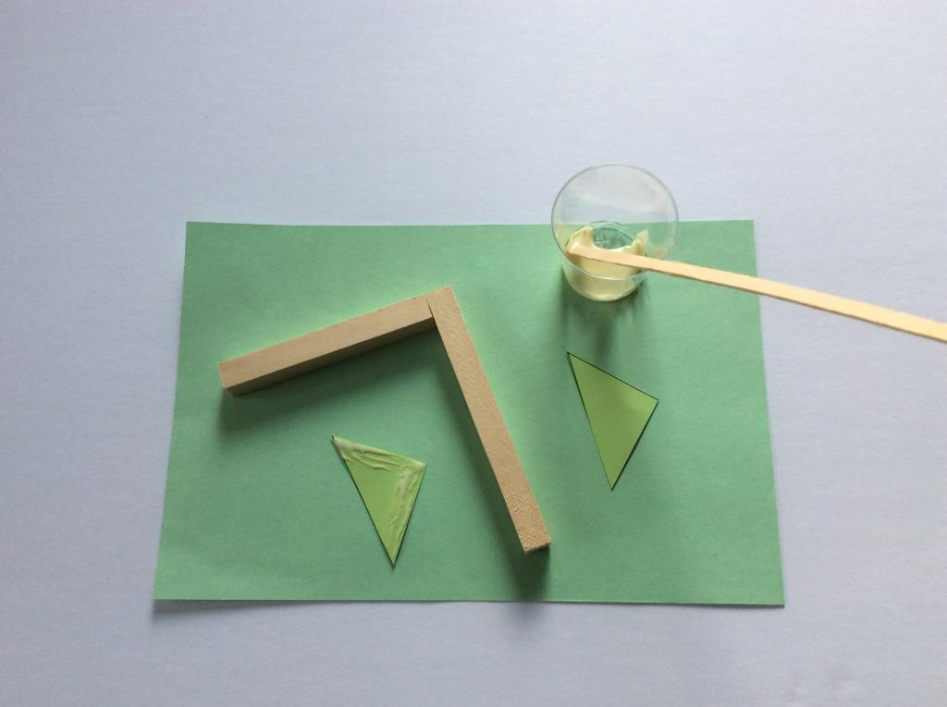
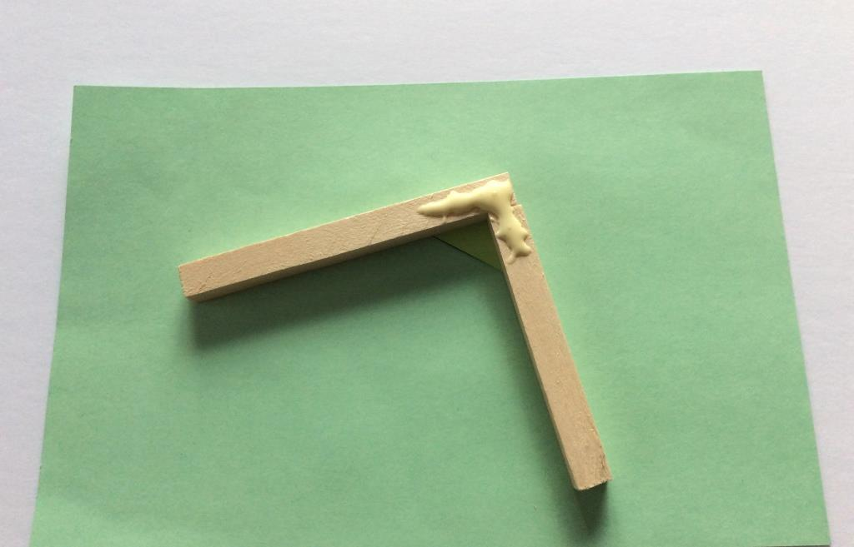
Using Wood Glue
Use a small amount of glue, the glue holder and stirring stick
√
X
6

Slide 7
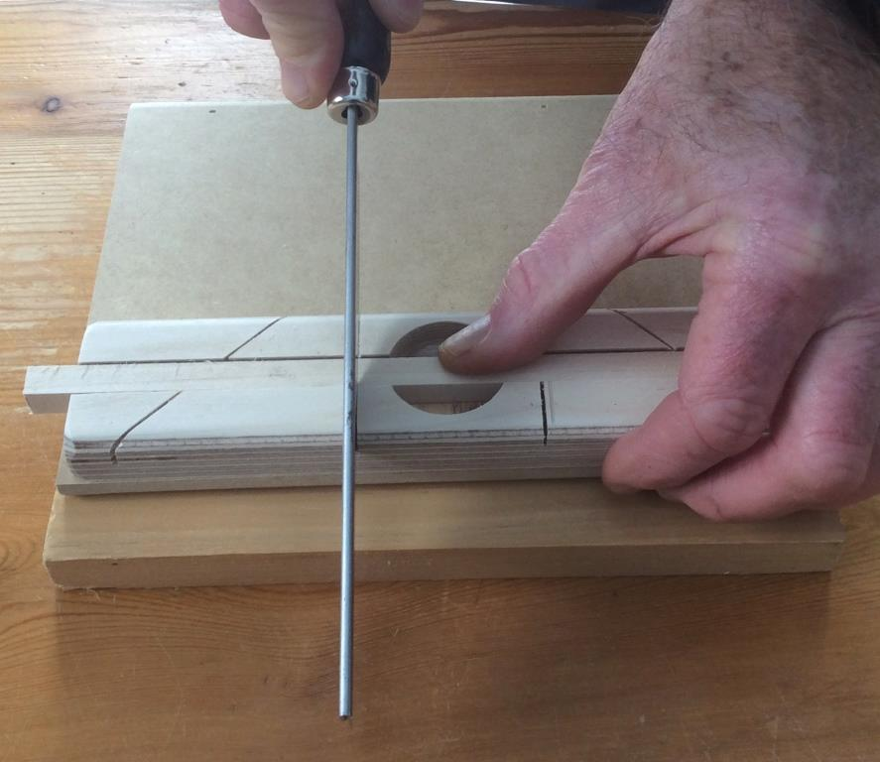
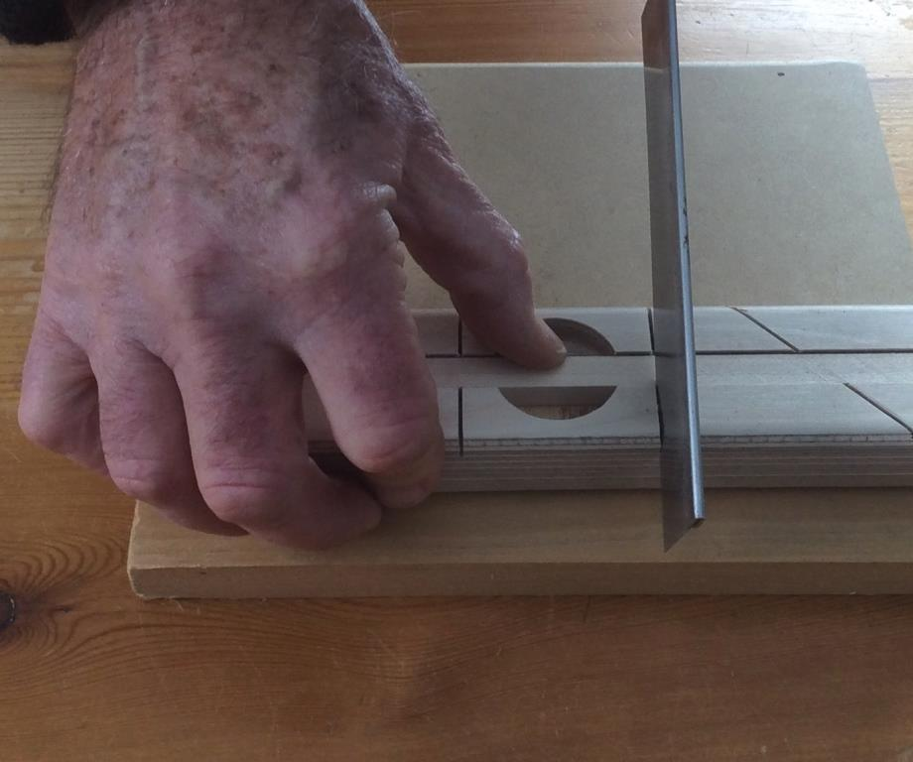
Using the miter box and hand saw to cut wood
RIGHTY
LEFTY
7

Slide 8
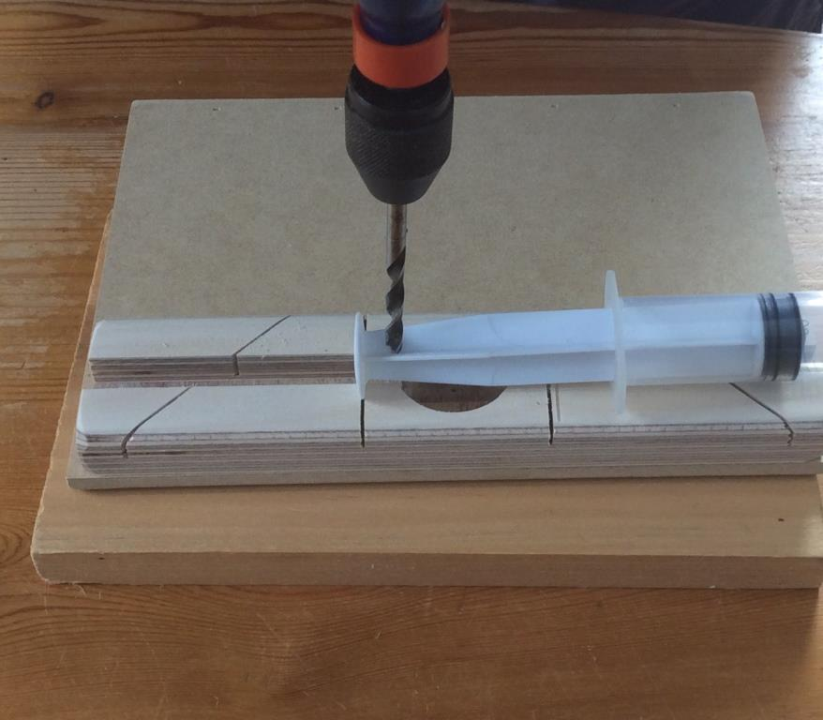
Using the hand drill to drill a hole in a syringe
Keep the drill upright – ask your partner to make sure and lend a hand to keep the piston syringe still. Press down while drilling. To remove the drill bit from the hole rotate in the same direction and pull the drill up.
8

Slide 9
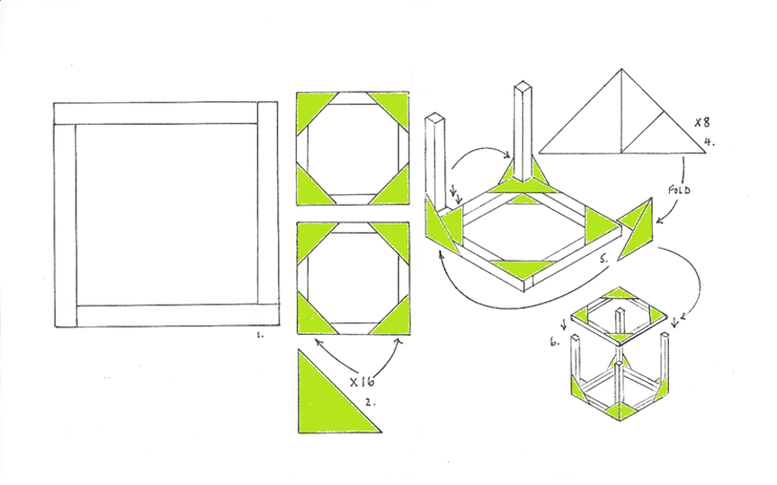
Making the cube
9

Slide 10
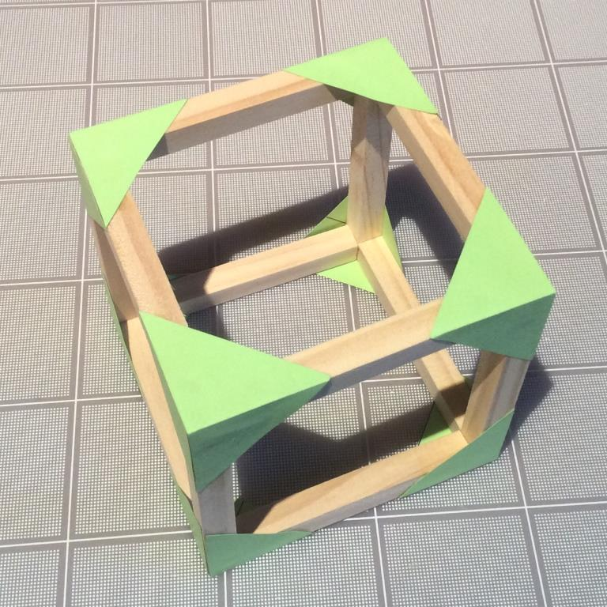
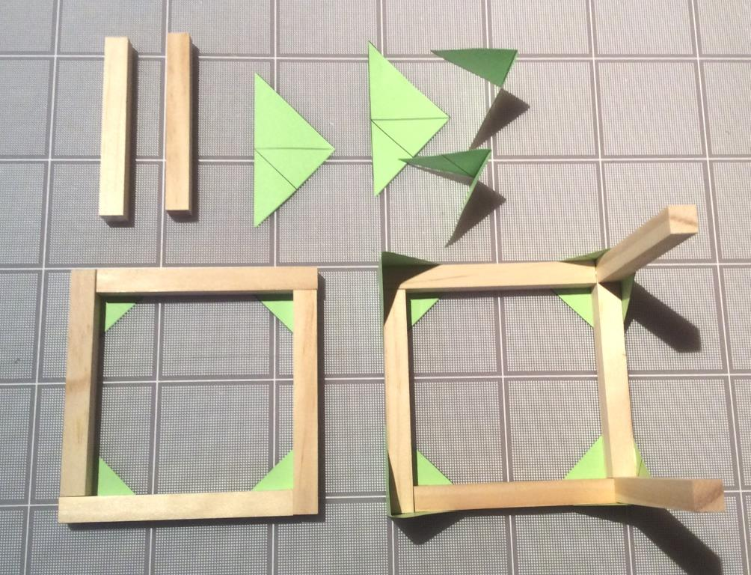
USE DOUBLE GUSSET
10

Slide 11
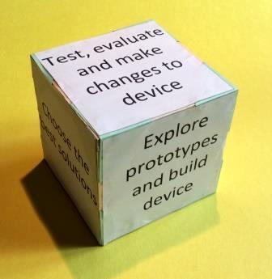
Glue the sides on the Cube
11

Slide 12
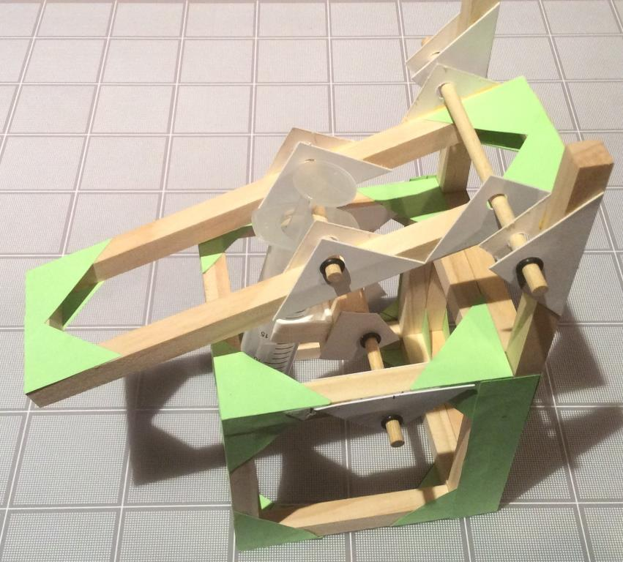
Build the Lifter
12

Slide 13
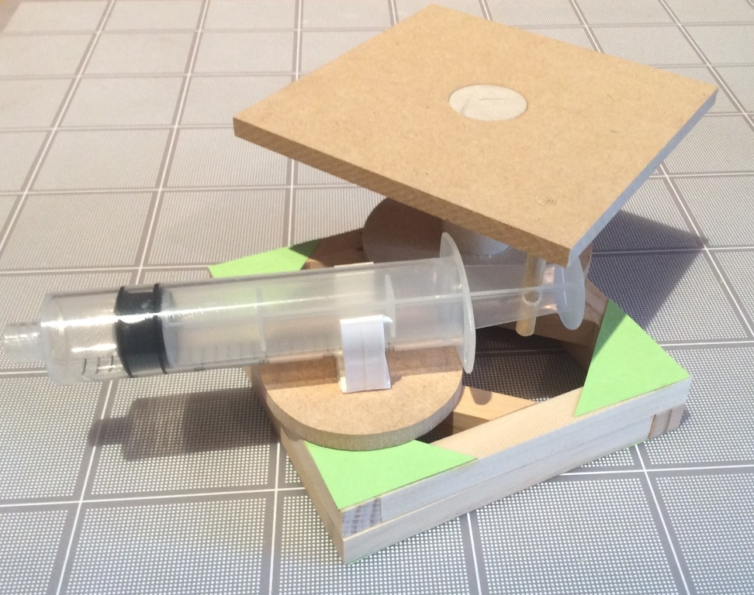
Build the Rotating Platform
13

Slide 14
REFER THE FOLLOWING DOCUMENTS:
Rules for Challenge Day
The Current Challenge
Challenge Rubric
Portfolio Checklist
Portfolio Template
Iso - Ortho Views illustrated
14

Slide 15
The Challenge – Portfolio Rubric
 | Criteria | Points
Portfolio Rubric Contents to include: Total possible points - 50 | Quality of portfolio’s presentation including title and index pages A detailed outline of each team member’s participation in the production of the portfolio and planned production of the device At least 3 illustrations of initial design concepts of possible device Materials used to build prototype from the Workshop Kit including dimensions Description of the use of the principles of a strong and stable structure Rationale used to decide on the type of fluid power used and where to place the piston-syringes Isometric drawing of the portion of the prototype used to grab the object Orthographic drawings showing dimensions and construction notes List of alternatives materials that would have been useful with reasons why Evaluation of prototype including the conclusions from making it | 0-5 0-5 0-5 0-5 0-5 0-5 0-5 0-5 0-5 0-5
15

Slide 16
MAXIMISE YOUR TEAM’S PORTFOLIO POINTS (45 Available)
A detailed outline of each team member’s participation in the production of the portfolio and planned production of the device
Think about your team – who is good at what?
Think about how long you have to design and build your prototype and record the process in your portfolio
At least 3 illustrations of initial design concepts of possible device
Detail helps you think about the connecting parts!
A list of materials used from the Workshop Kit including dimensions
Record the parts you use and their dimensions (important!)
List of alternative materials that would have been useful with reasons why they would have been so
This is asking you to think “outside the box” literally
16

Slide 17
Structural Strength
Weight
Glue
Weight
Option #1
Option #2
GROUND
Which Option is a more structurally sound Design? -- Why?
What else can go wrong and how do we improve it?
17

Slide 18
Structural Strength
Paper
Gussets
Wooden
Cross Brace
Weight
Weight
Force
Force
Option #1
Option #2
GROUND
Observations? Pro’s and Con’s of each option?
Reasons to use one option vs another? Other Considerations?
18

Slide 19
Structural Stability
Load
2lb
Pivot Shaft
Arm
1lb
Base
½lb
GROUND
Any concerns with this structure?
19

Slide 20
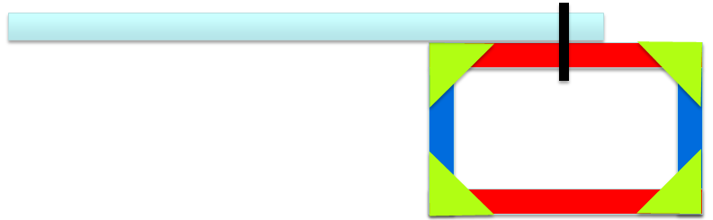
Structural Stability
GROUND
The device will tip over - Why?
How do we prevent this?
20

Slide 21
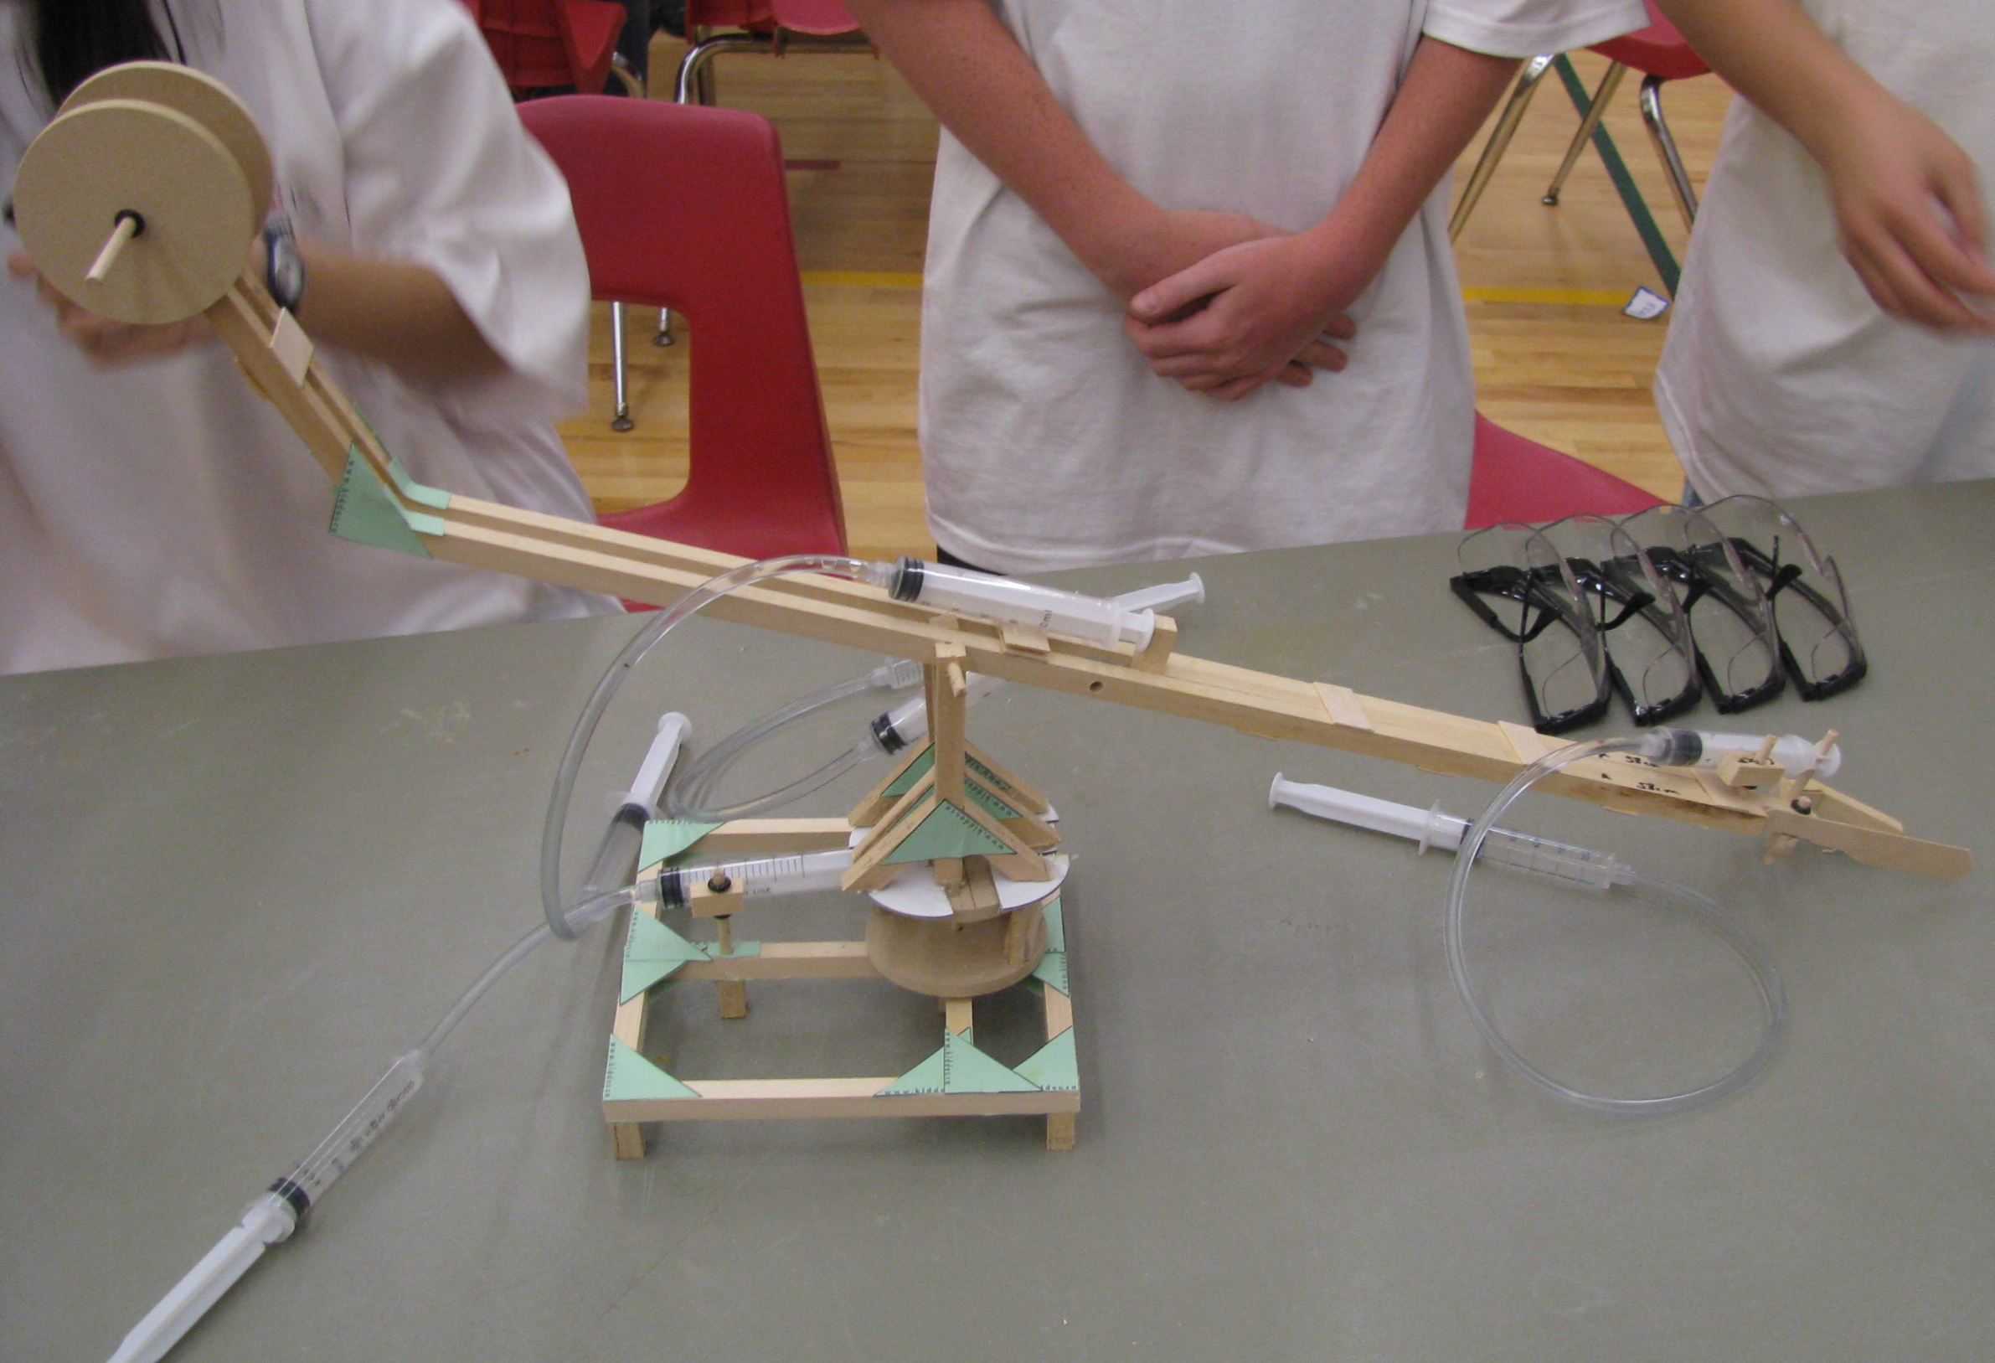
Placement of Hydraulic or Pneumatic Systems
Rationale used to decide on the type of fluid power used and where to place the piston-syringes. This device is an elegant design where the actuating pistons (the pistons that attach to the device) are placed so as to maximize levered movement
21

Slide 22
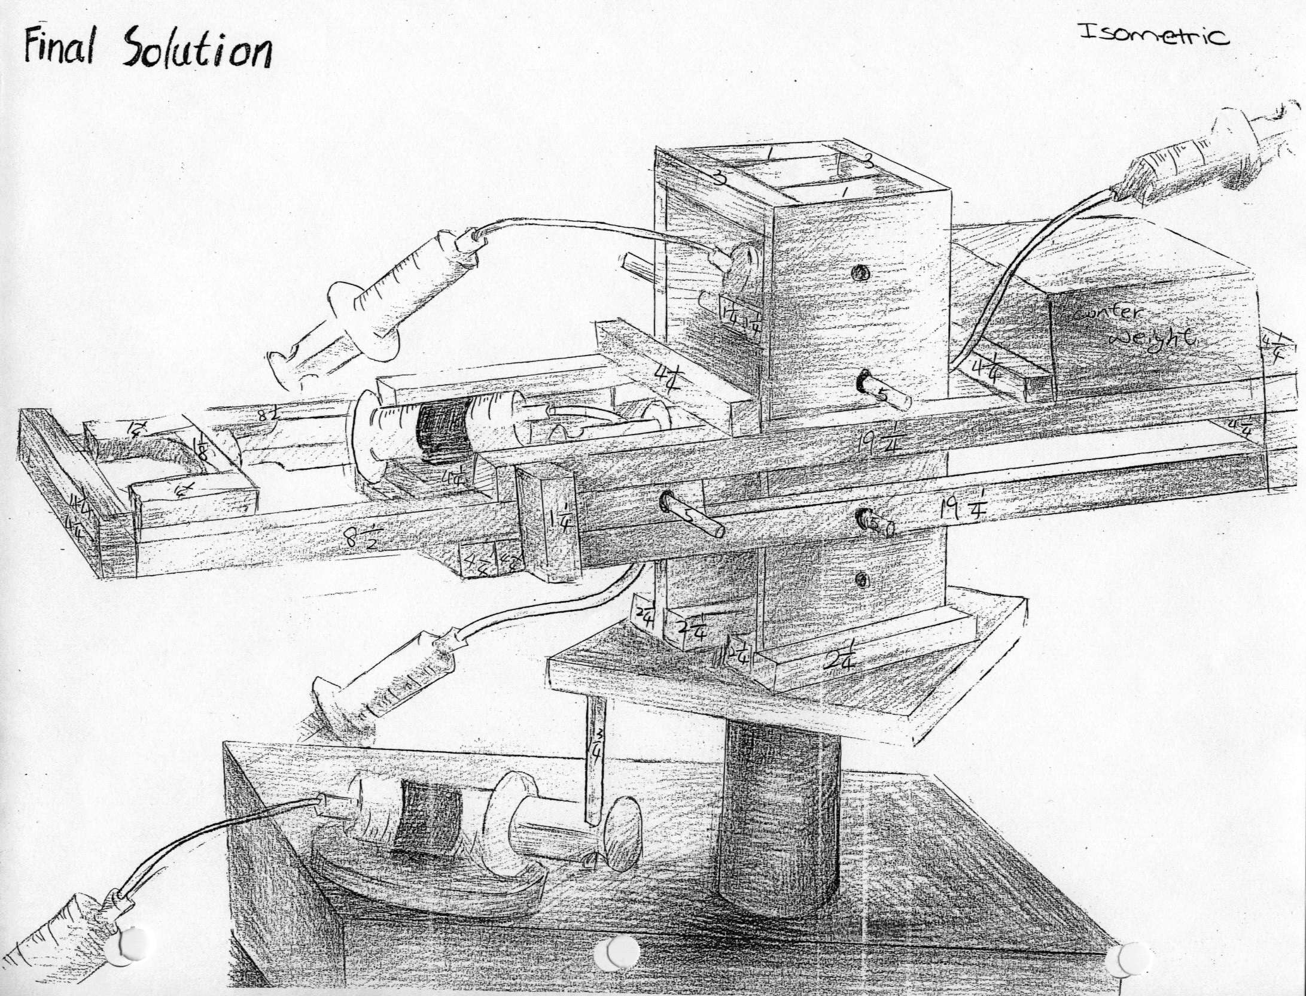
22

Slide 23
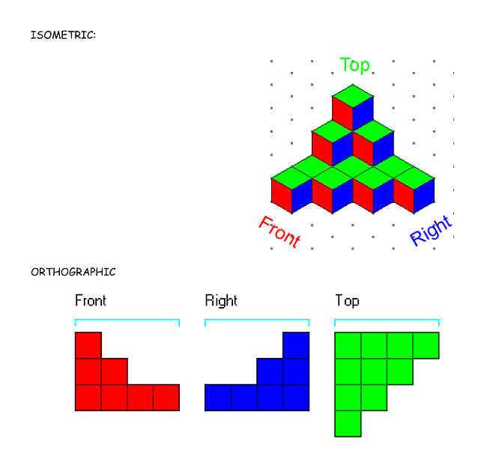
  An Orthographic & Isometric Lesson is available with the following curriculum: Plot Frame Criteria & Purpose, Orthographic View Creation & Methods, Isometric View Creation & Methods, Hidden Lines & How They Are Used and Practice Exercises
23

Slide 24
The Portfolio Template and Checklist
The Portfolio Review Template is considered the minimum requirement for your team’s portfolio.
The Checklist is a sample Index for your Portfolio
See sample Middle School Portfolio on Resources Center
24

Slide 25
Teamwork & Work Habits
The Challenge relies on teamwork to be successful
Successful teams will:
  Work together according to a time-line
  Assign & divide tasks
  Plan their work & work their plan
  Complete tasks in parallel
  Leverage individuals' strengths
  Won’t mess with other teams
25

Slide 26
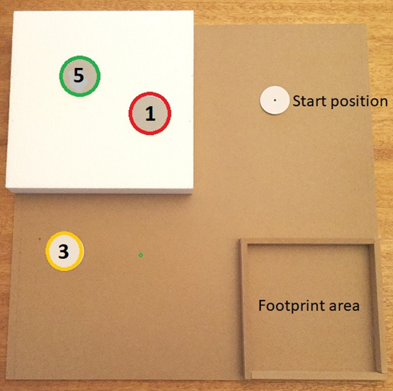
This is the 2024-25 Challenge layout board.
Your team must build a device that sits in the footprint area and moves a wooden cylinder from the start position to any one of three target areas.
An object placed upright on the target area is worth 1, 3 or 5 points according to the area.
The task is to accumulate as many points as possible in two minutes.
26

Slide 27
Discussion
Why is one destination area worth more points than the other?
What if you design a device that only works when using your hands?
How long will you have to move objects?
What tools/materials can you use to build your device on the Challenge Day?
Why is the Portfolio so important?
27

Slide 28
The Challenge Process
Objective
To design a device using only the supplied tools and materials, that can score as many points as possible.
Deliverable
Two copies of the portfolio
Challenge Kit
On the Challenge Day your team will bring your portfolio and tools. A Challenge Kit will be provided. It contains all the materials you will use including two extra 20cc syringes and 6ft. of extra tubing, and some glue sticks in case you need them
28

Slide 29
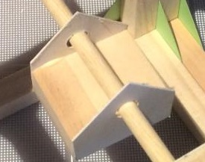
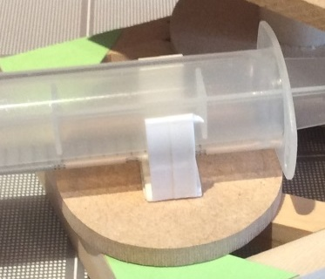
Using the piston-syringe clips
The #1 reason why devices fail is because the clips are not fixed correctly to the device. A platform must be used to accommodate movement and the clips must be secure. Use the gray clips where a greater resisting force is required. Locate the clips first before fixing them to the device. Using hot glue is not a good alternative.
29

Slide 30
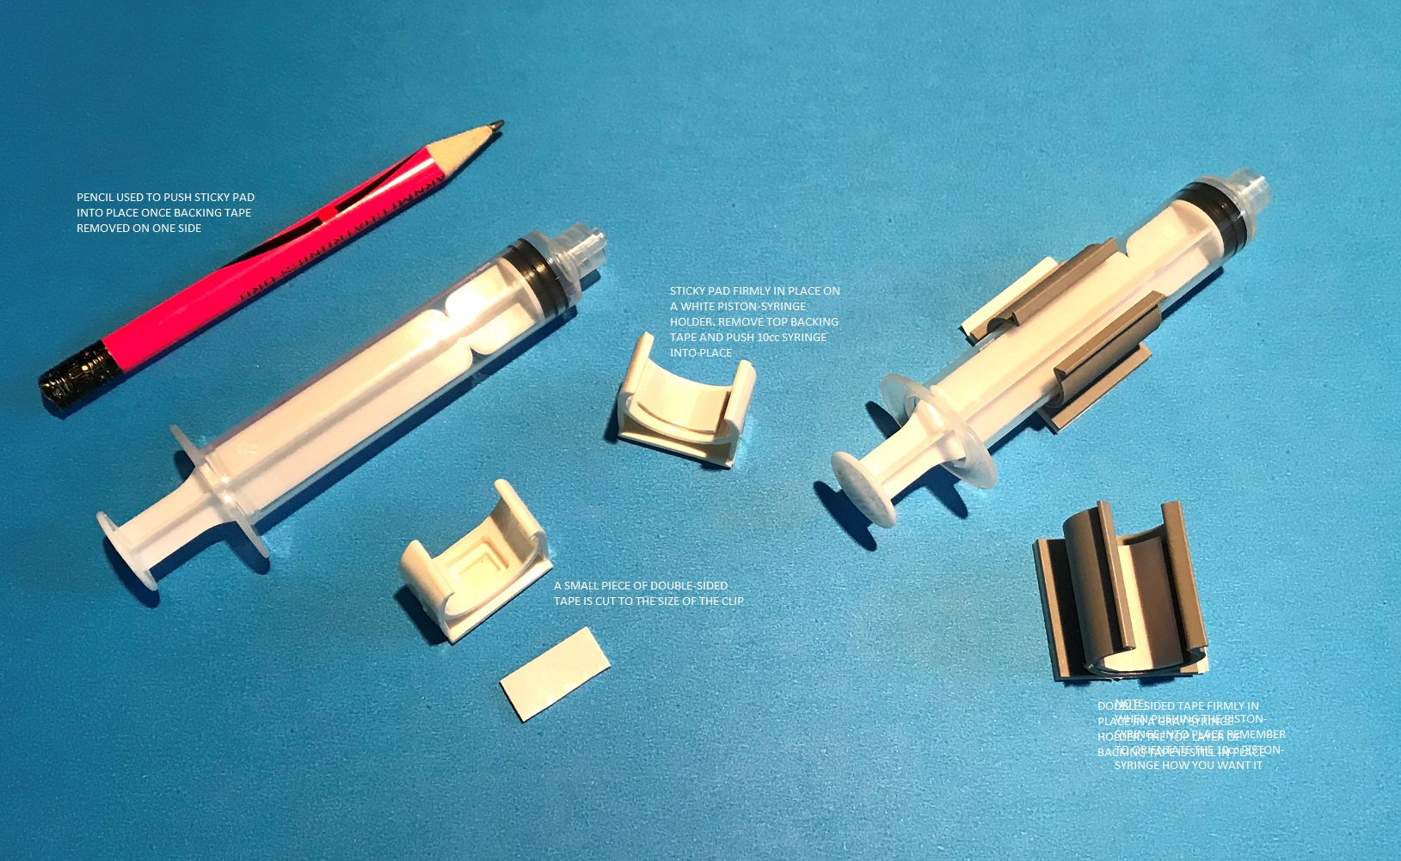
Connecting the 10cc piston-syringe to white and gray clips
For gray clips use a piece of double-sided tape cut to the size of the clip. Peel off one (1) side of the tape and insert firmly into clip.
Alternatively use the smaller white clips provided. NOTE: one of the 10cc piston-syringes has a hole in the plunger.
30

Slide 31
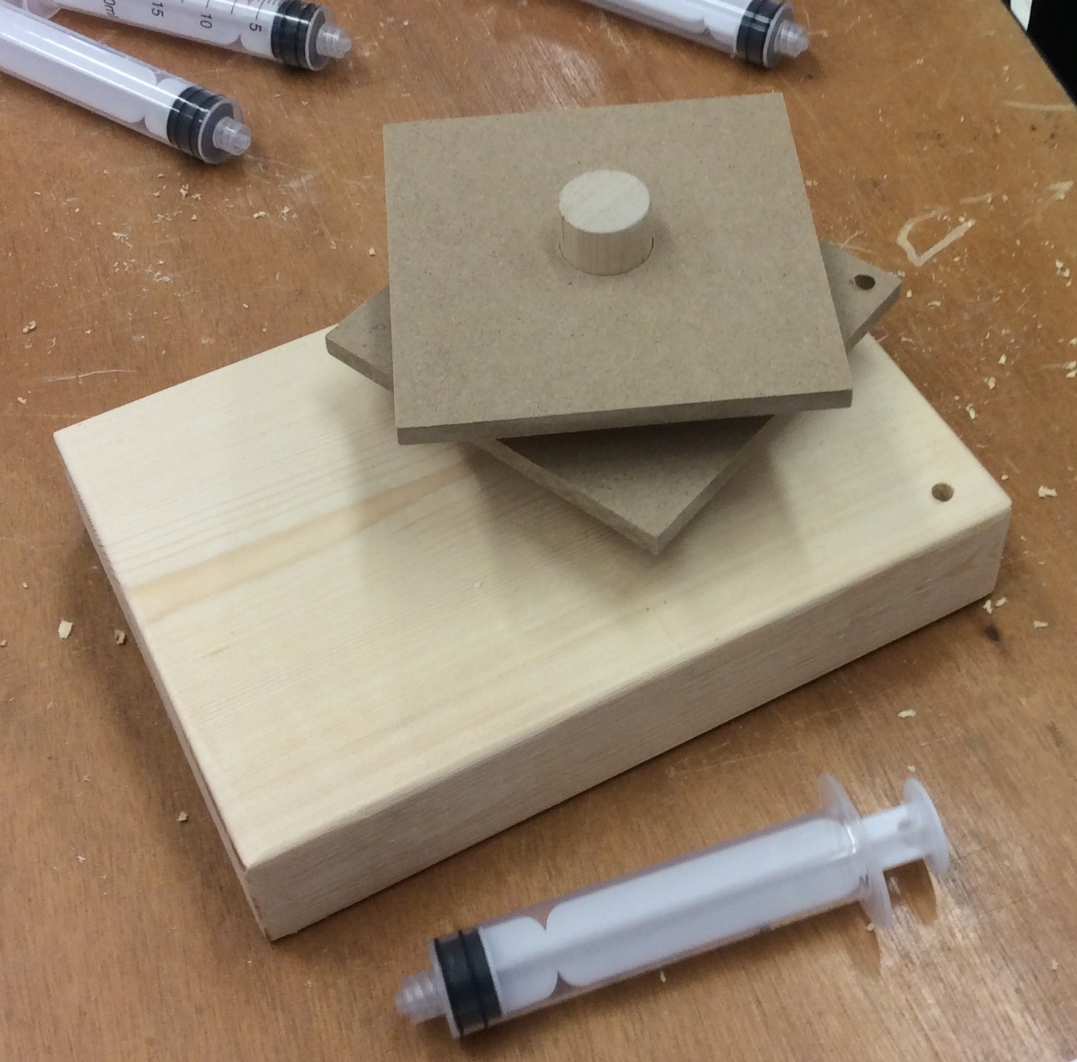
Contents of the kits – Base block and 4” Squares
The Workshop kit and the Challenge Day kit contain a large wooden base with a hole in it to accommodate a large diameter dowel found in the kits. This can be used as a stable base if your team decides to do so. The hole is off-center and the dowel may require sanding to fit as your team wants.
The large dowel fits the two square platforms in the kit. The picture shows that this team decided to drill a hole in the lower platform for a dowel and another hole in the base presumably for a rotating wheel with a piston holder fixed to it – an arrangement demonstrated by the Workshop Rotating Platform kit.
31

Slide 32
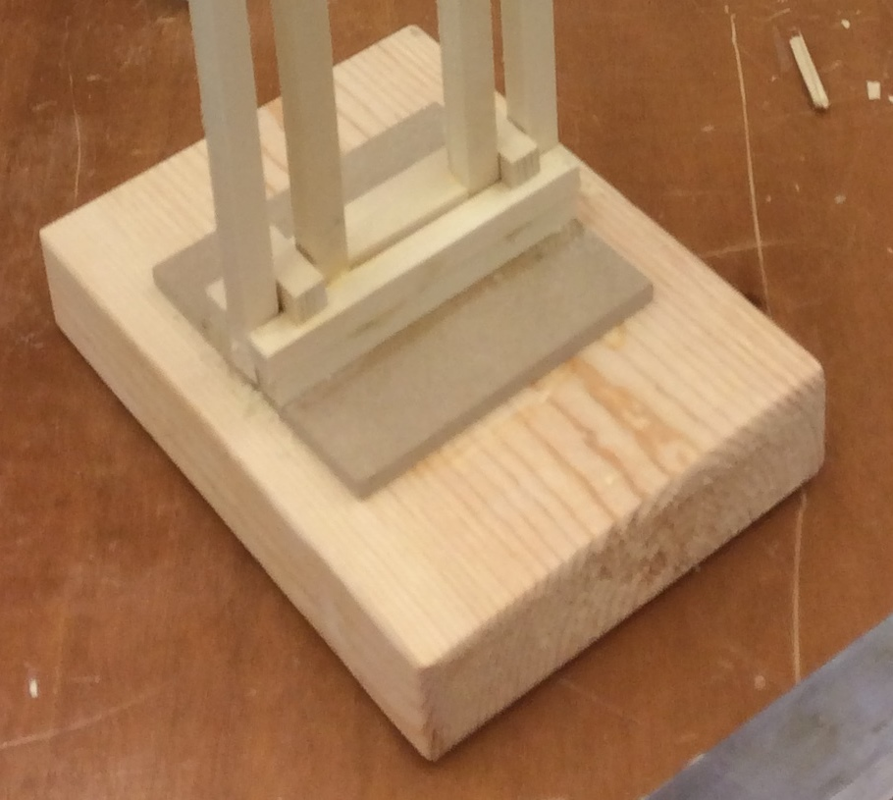
In this picture the large wooden base was used in a different way – there is no large dowel involved and a fixed structure is being built upon it
32

Slide 33
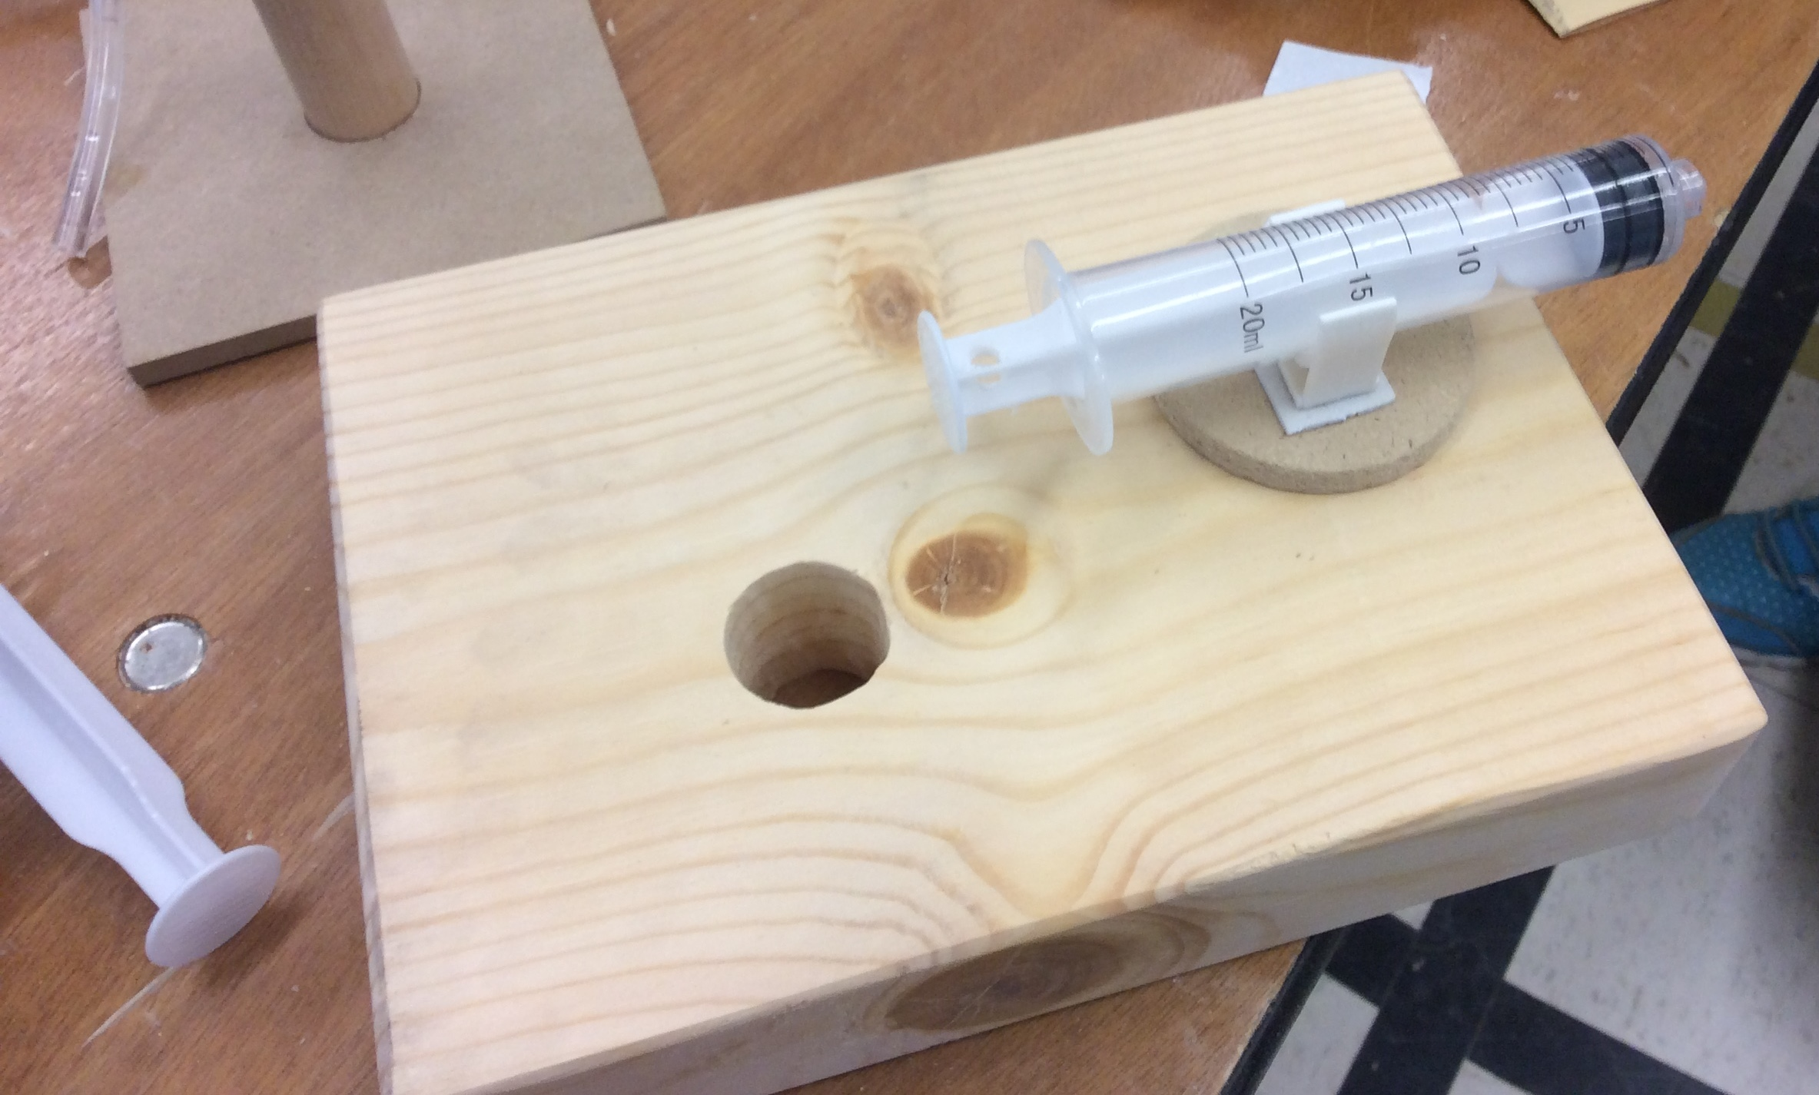
The Workshop kit and the Challenge kit both contain syringe holders. It has a “one-time” sticky pad on its base and must be pushed firmly onto a paper, plastic or a wooden surface to adhere sufficiently to hold the 20cc or 10cc piston syringe in place. A double-sided sticky pad can be used with it if a larger area is required.
Wood glue and hot glue are NOT efficient ways to secure a syringe holder
The arrangement in the picture above may have potential problems. Why?
33

Slide 34
QUICK RECAP:
SAFETY is our number #1 concern
ALL motion must be controlled by fluid power
USE your materials wisely
DOCUMENT everything in your portfolio
All materials to build device are provided
Bring tools
Use your time efficiently
Have fun and work well
34

Slide 35
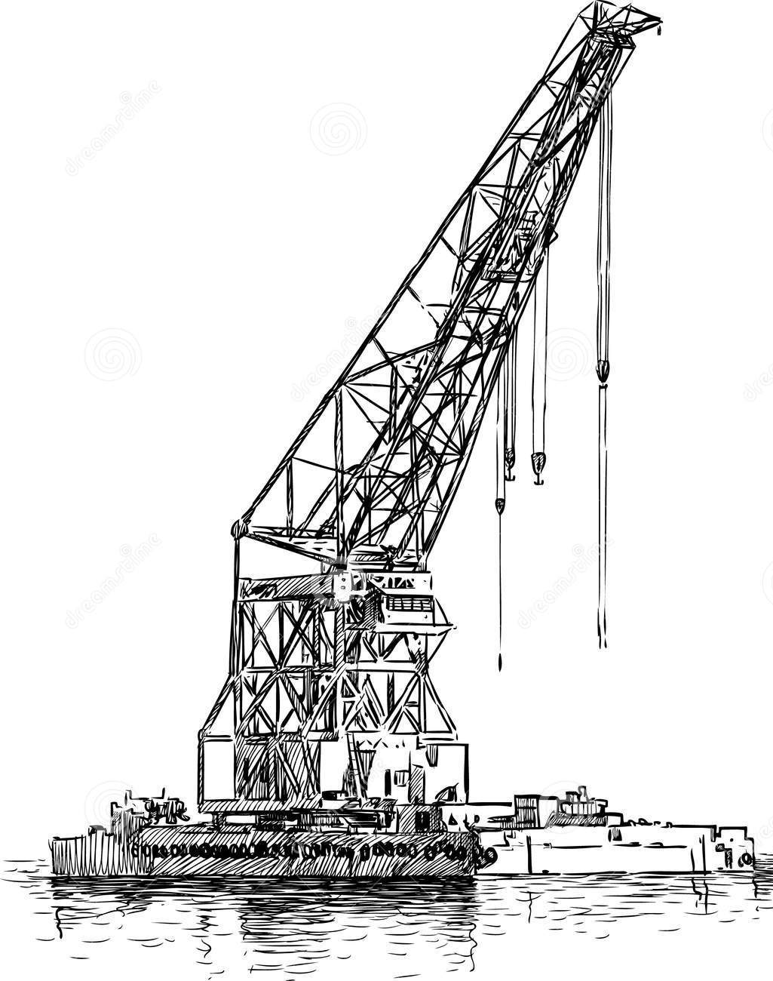
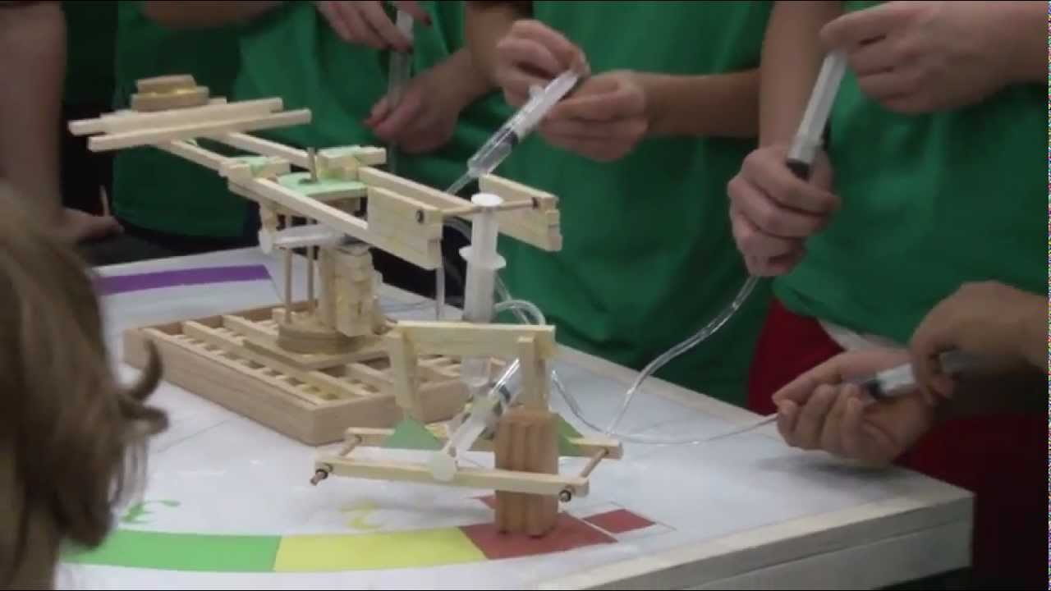
Watch videos from previous Fluid Power Action Challenges on YouTube or Google web (“Fluid Power Action Challenge”)
Successful products are always made by carefully researching existing products.
Notes:
https://www.youtube.com/user/NatlFluidPowerAssn

Slide 36
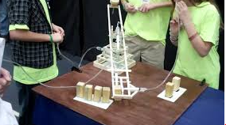
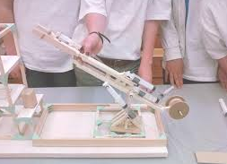
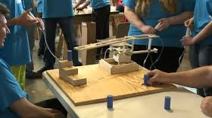
Examples of previous projects
YouTube & Google
“Fluid Power Action Challenge”
Challenge Video 2
Challenge Video 3
36
Notes:
https://www.youtube.com/user/NatlFluidPowerAssn

Slide 37
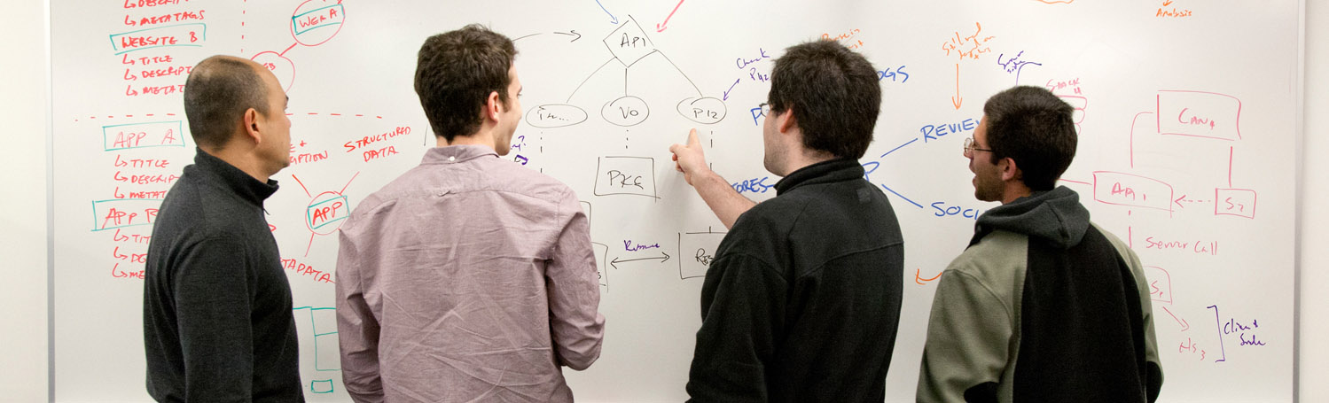
Sketching is a way of communicating ideas

Slide 38
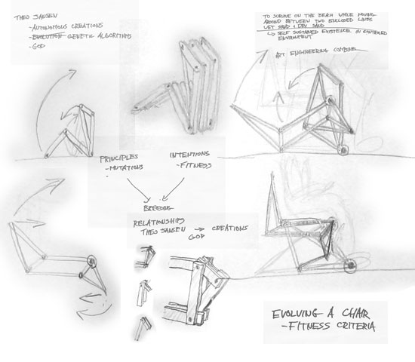
Sketching is a way to explore new ideas.
Notes:
Fast way to explore options – sketch it first, always

Slide 39
Examples of team tasks:
Read project rules
Research clamping mechanisms
Sketch ideas for clamping mechanisms
Research rotating mechanisms
Sketch ideas for rotating mechanisms
Research rotating mechanisms
Build prototype mechanisms
Sketch whole robot design
Build a whole prototype
Practice challenge activity
Read portfolio scoring rubric
Generate final sketches of design for portfolio
Write a description of the principles of strength and stability
Write an explanation of the chosen location of your syringes
Have writing reviewed by a mentor
Assemble all portfolio elements into a final report
Who will be responsible for what?

Slide 40

Identify concrete tasks and milestones
Read rules and scoring rubrics
Build prototype rotating mechanism
Have draft portfolio reviewed by a mentor
Milestone:
Assemble writings and sketches into final portfolio
Milestone:
Finalize robot design
Research clamping mechanisms

Slide 41



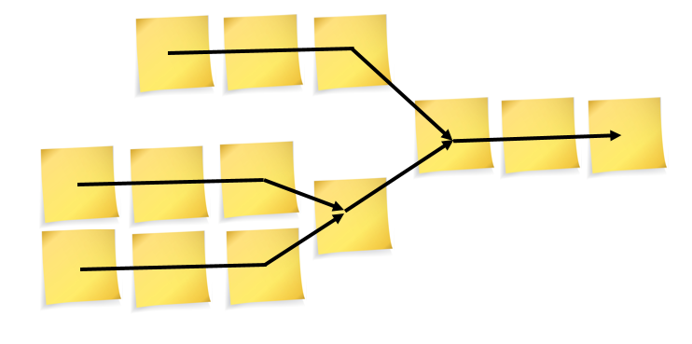
What you should be doing right now
Identify 3 tasks or milestones
Lay out the schedule
Choose dates for your milestones

Slide 42


This document was originated by:
Additional contributions by:

