Slide 1
FINAL PRESENTATION Michigan Technological Univ.
Advisor: Dr. Dave Wanless
4/12/2024
University Image Logo

Slide 2
Team Introduction
Isaac Steers
Tate Newlin
Cheyenne Goff
Luke Hensley
Collin Little
Notes:
All

Slide 3
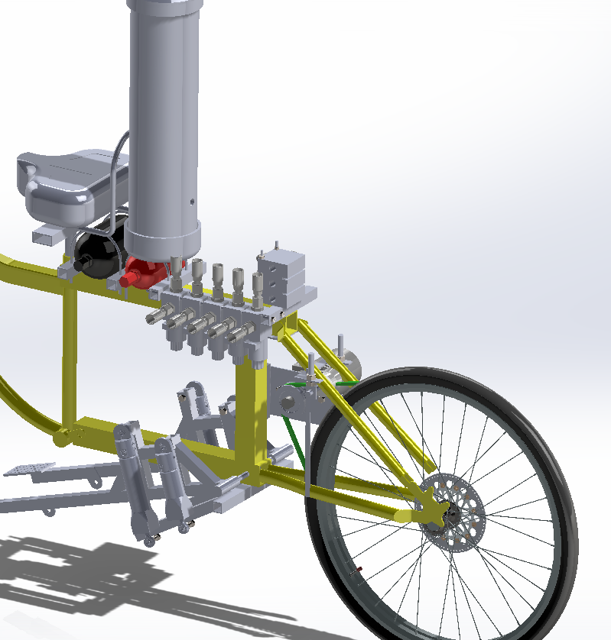
Key Design Choices
Pump Action Pedals
Dual Rim Pulley System
Motor Mount
Accumulator attachment
Relief/control valve attachment
Tensioner

Slide 4
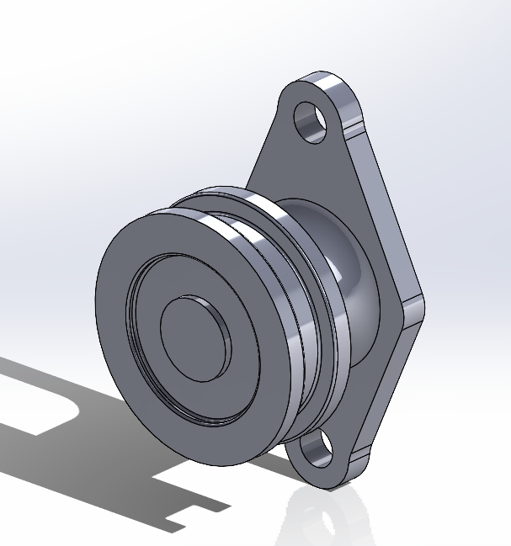
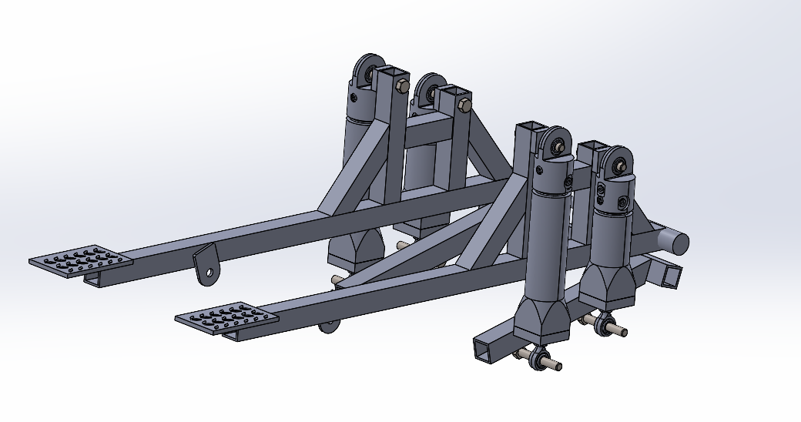
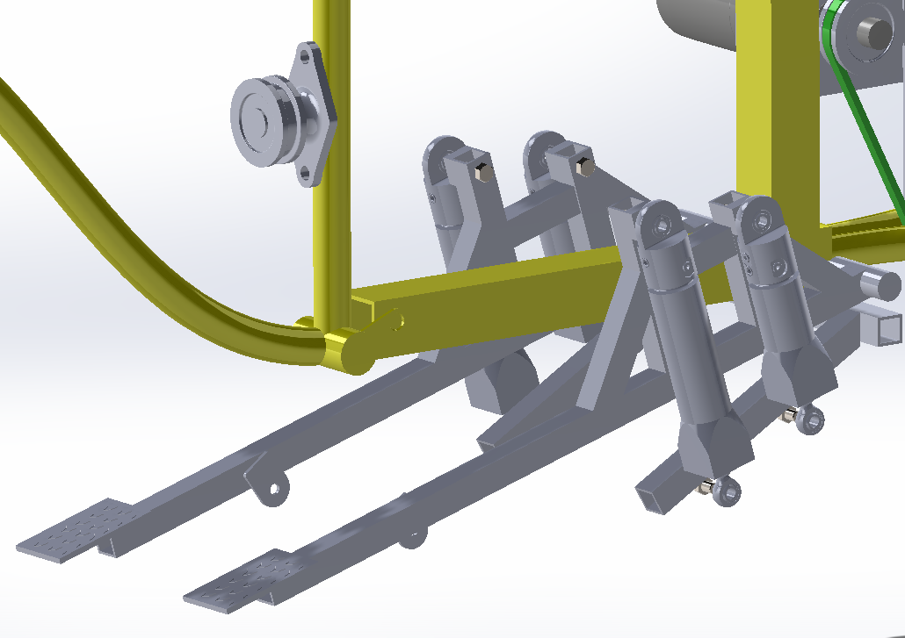
Pedal Design
Small piston 3.8 inches from axis of rotation
Pedals are 28” long from axis
Aluminum square stock for lightness
Steel wire on a pulley for pedal return

Slide 5
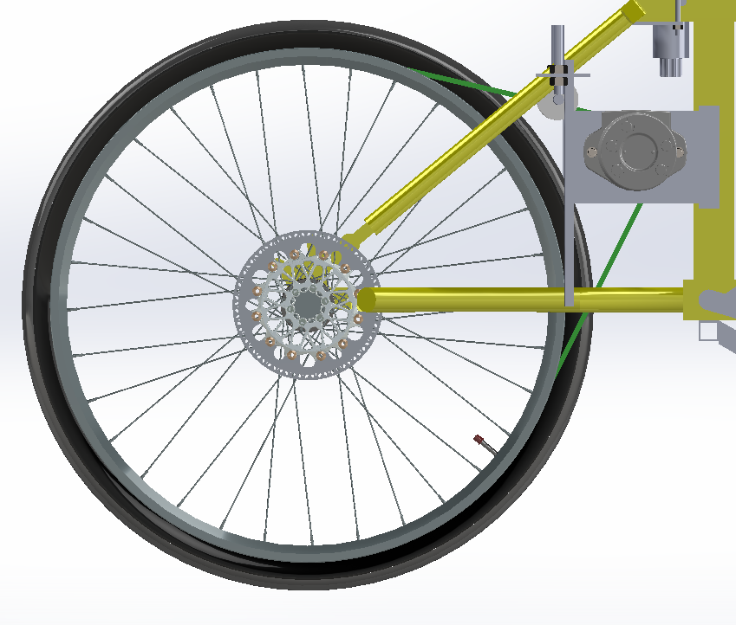
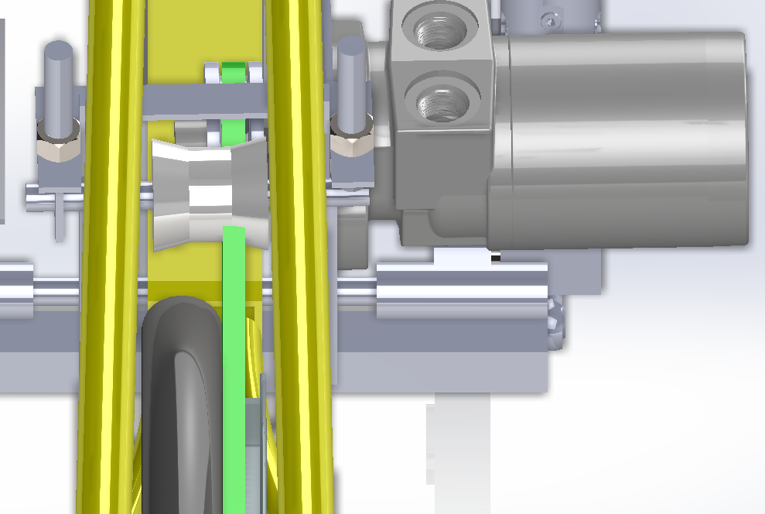
Dual Rim Pulley Design
Two 26” rims tig welded together
0.35” thick belt to motor
Position of motor based off location of the belt rim

Slide 6
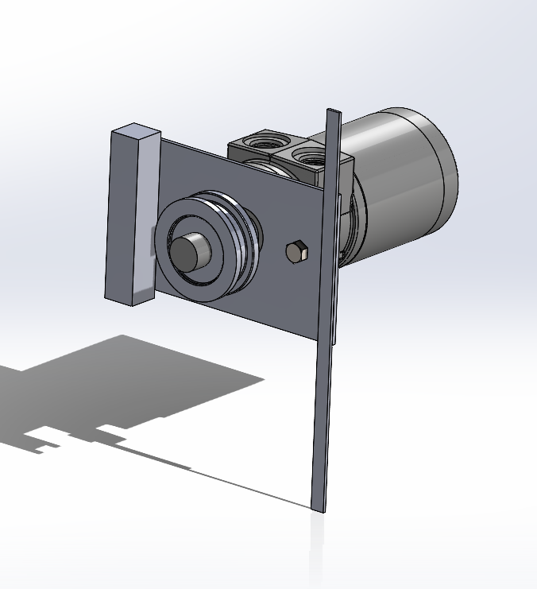
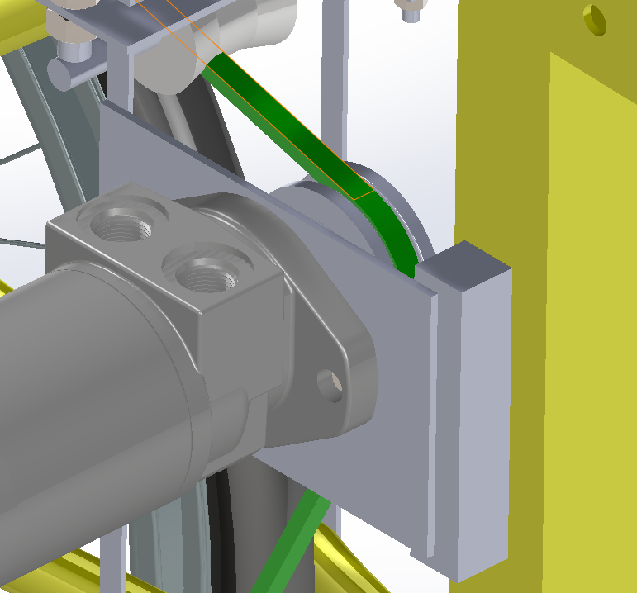
Motor Design
Casappa gear motor (0.683 in³/rev at 100% efficiency, 26.25 in. lbs, 115.86 rpm, 0.3805 gpm)
Pulley attached to Motor that drives the belt (3in pulley)
Welded Motor Mount and custom bracket

Slide 7
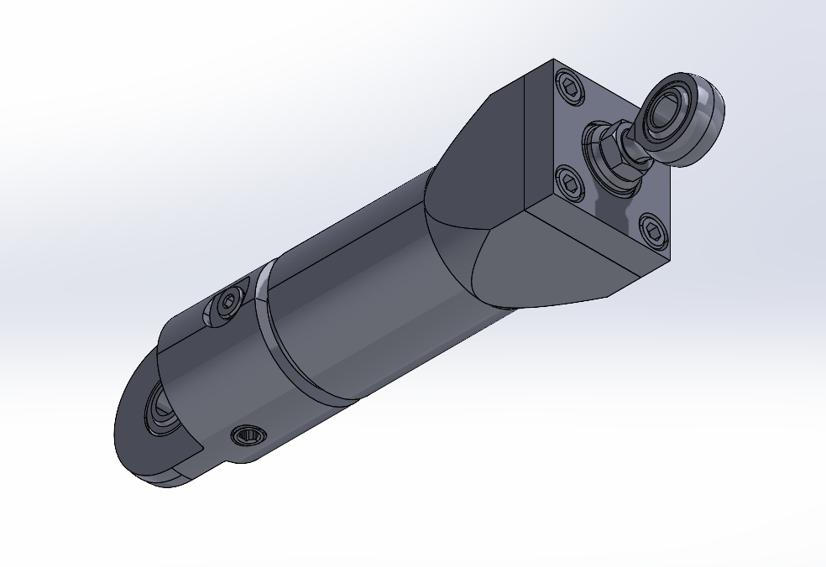
Cylinder Design
Cylindrical pistons are used to utilize leverage and linear motion
Different size pistons used as gearing
Electronic control gear selector
Stroke is 2.5” for small and 5” for large pistons
Displacement is .85 in^3 and 1.7 in^3 for small and large respectively
Cylinders manufactured by Jarp Industries

Slide 8
Electronic system
Envision PV500 screen (Iowa Fluid Power Supplied)
Envision MC2 controller
Barksdale Bps3000 pressure sensor
Balluff BSP pressure sensor
Two Milwaukee M18 batteries
Custom Deutsch connector wiring harness

Slide 9
Electronic Programming
An touchscreen design solved problems from previous years (manual valves)
Powervision used to program the screen
CoDeSys used to program the controller
Different buttons for specific modes
Separate logic for gears and modes

Slide 10
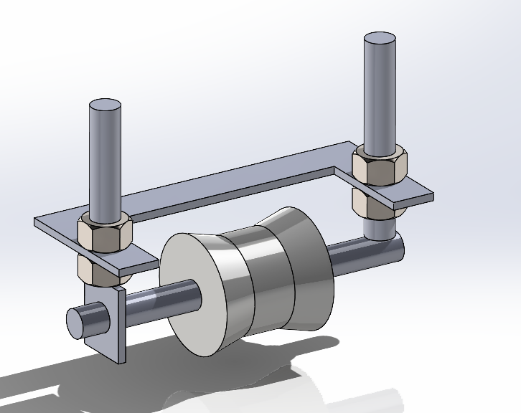
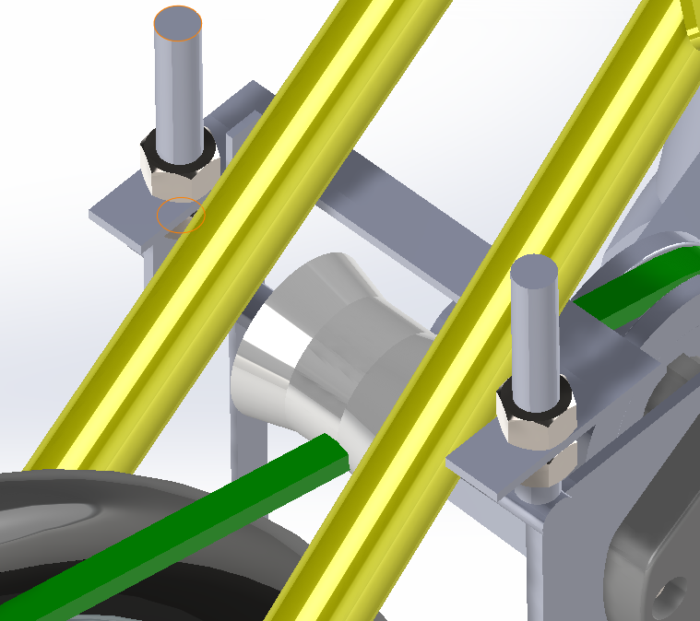
Tensioner Design
Chamfered nylon
welded threaded rods to tension
Attached to Motor Mount (weld)

Slide 11
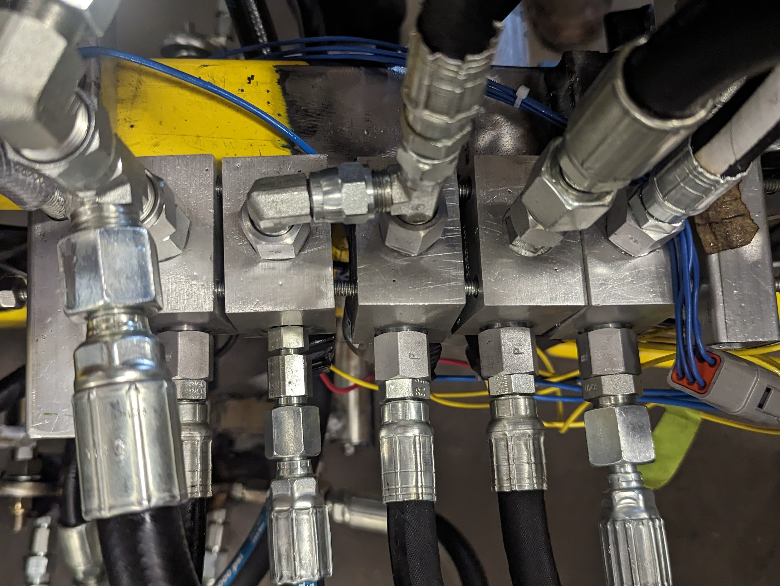
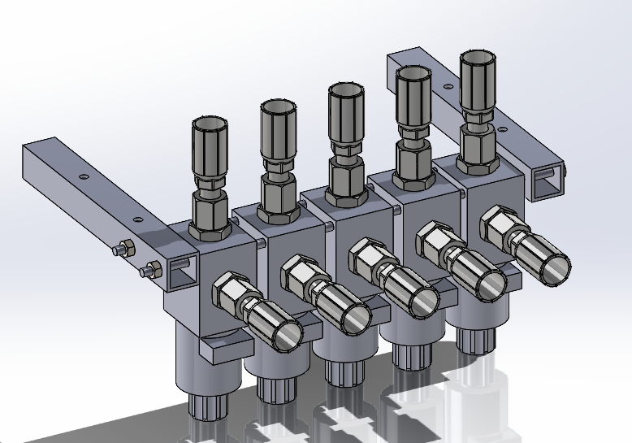
Valve Selection
Sun Hydraulics cartridge valves and manifolds
14 V solenoid actuation

Slide 12
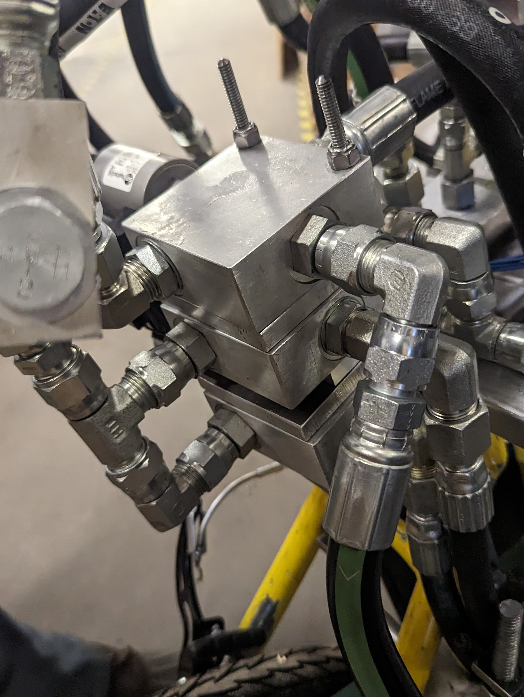
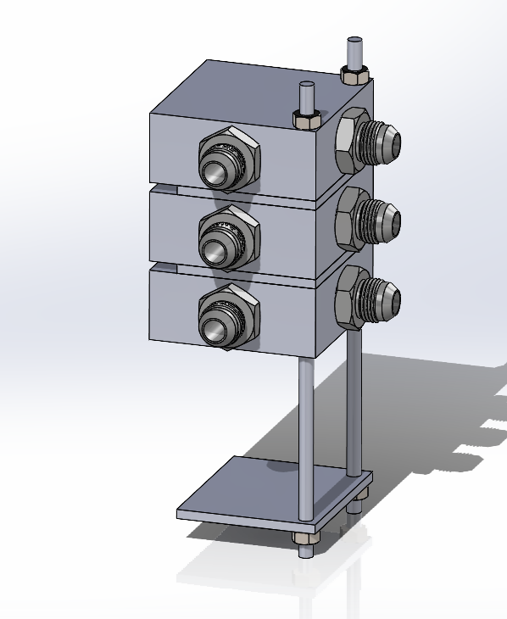
Valve Mount Design
Two manifold banks
Threaded rods through manifolds
Nuts clamp the manifolds to the frame
Attached to a back plate or the accumulator mounts

Slide 13
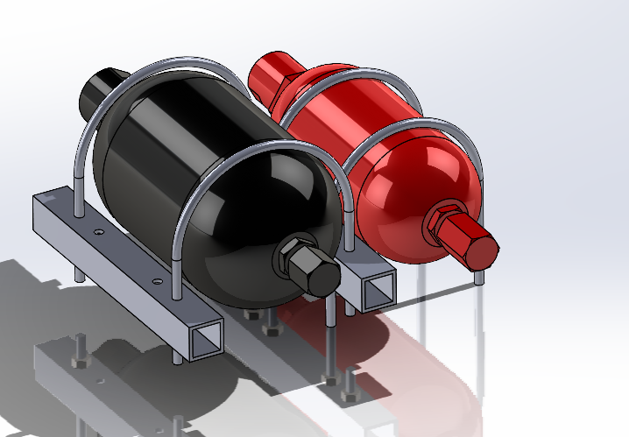
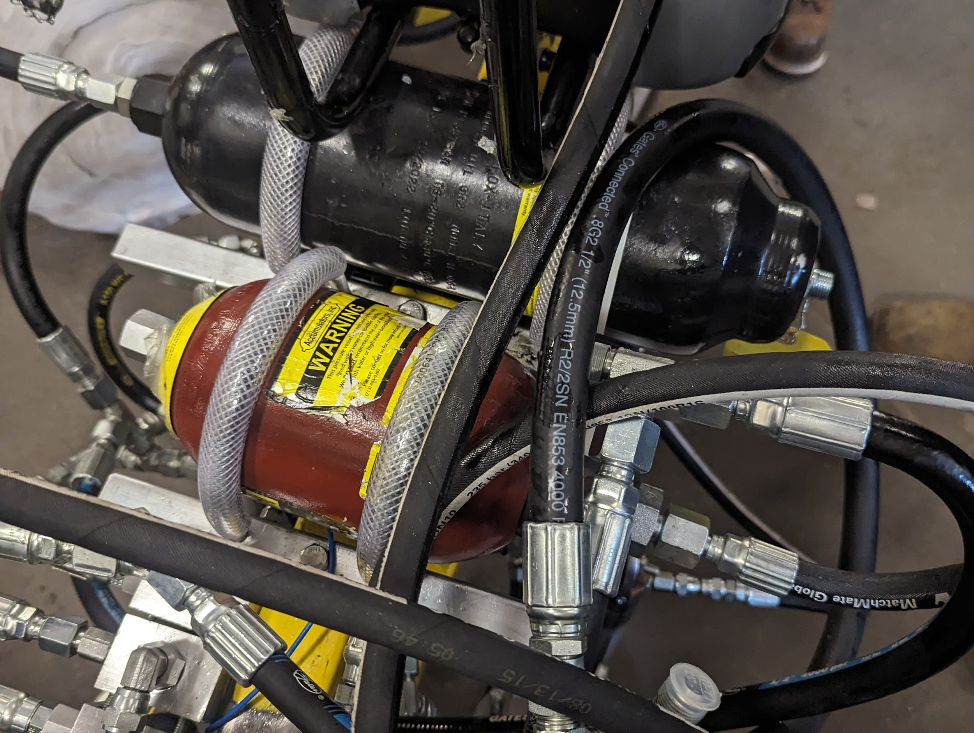
Accumulator Design
Bent threaded rod attached to 1x1 aluminum square tubing for mounting
2 accumulators (1.89 liter & .945 liter)

Slide 14
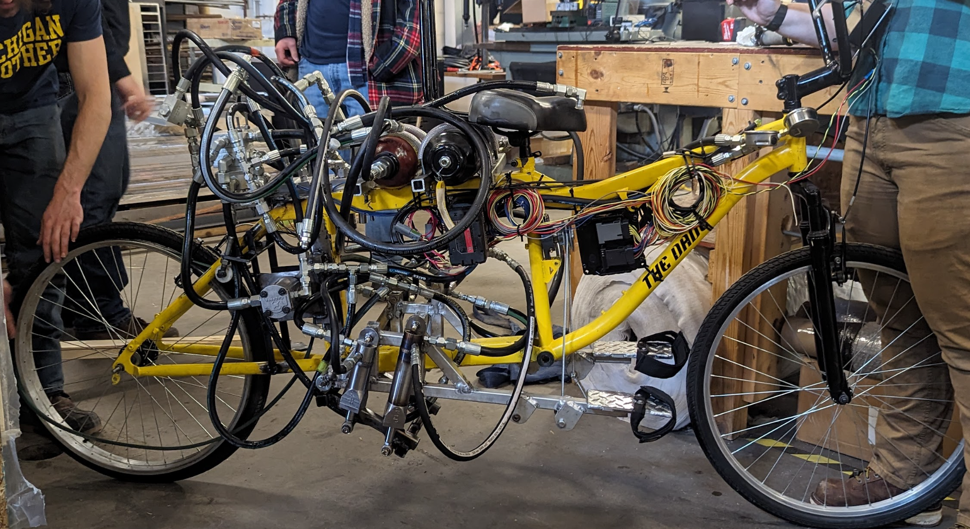
Vehicle Construction/Final Vehicle
Primarily done on our own, with tools and materials from the MTU MMET Shop
Original plans were much different from the final outcome

Slide 15
Vehicle Testing
Initial testing was done to check for piston function
Piston to motor fluid movement check
Connection and hose failures
Calculations and earlier tests show it will work

Slide 16
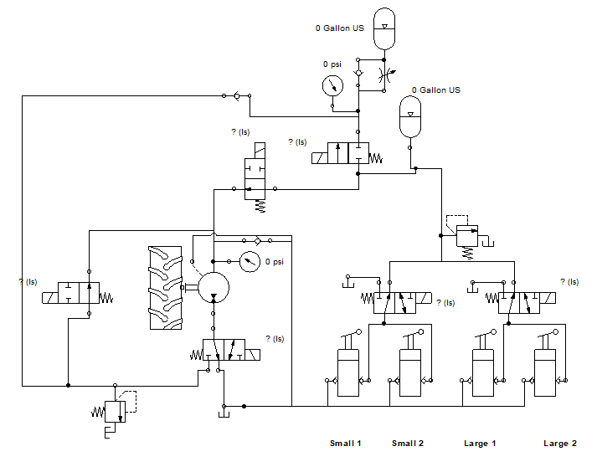
Rigged Schematic

Slide 17
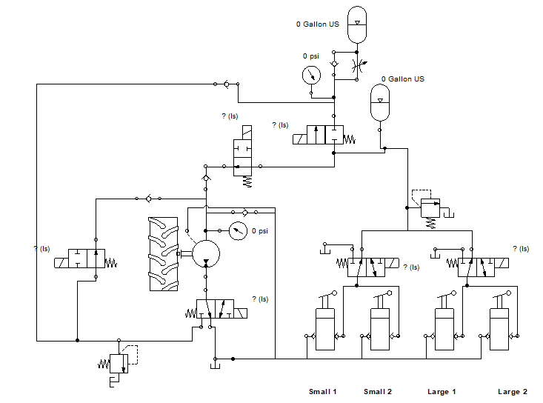
Competition Schematic

Slide 18
Lessons Learned
Start designing and planning sooner
Go through hose and valve connections early
How to deal with last-minute issues
Small errors can change an entire design
Proper fittings for circuit & components

Slide 19
Thank You
Josh Scarbrough IFP
Joe Jackan from Jarp Industries
Ernie Parker
Dave Wanless
MTU MET department

