Slide 1

Final Presentation
Kennesaw State University
April 12th, 2024
Notes:
Hello everyone welcome to our midway review for the NFPA FPVC

Slide 2







Team Introductions
Stefan Glende
Project Manager and Hydraulic Design
Avery Garrett
Mechanical Design and Simulation
Matthew Fierro-McCarthy
Pneumatics and Vehicle Testing
Austin Arnold
Calculations and Testing
Brandon Tomaskovich
Electronics and Mechanical Design
David Amaya
Mechanical Design and Testing
Notes:
Home Depot Role: Solve business related issues, developed data analysis skills

Slide 3

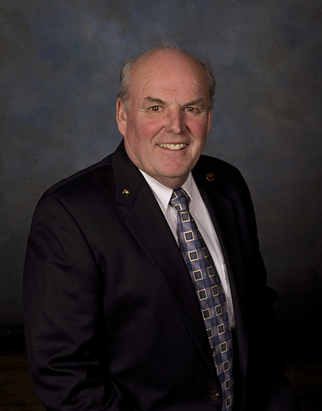

Team Introductions
Laura Ruhala Ph.D.
Asst. Dept. Chair
Mechanical
Engineering
Kennesaw State University
Richard Ruhala Ph.D.
Professor
Mechanical Engineering
Kennesaw State University
Ernie Parker
International Fluid Power Society
Cory Fisher M.S.
Sun Hydraulics

Slide 4
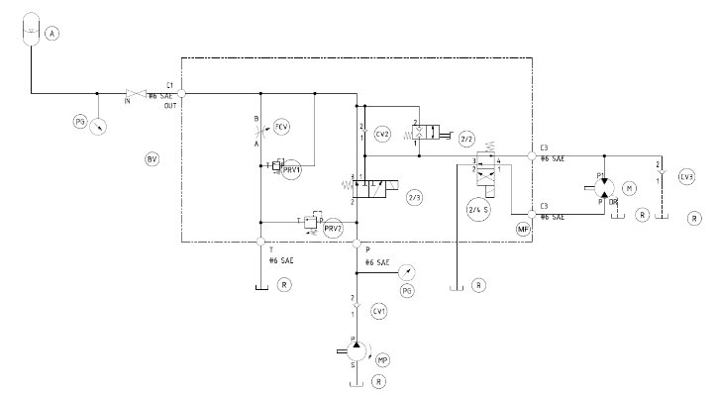
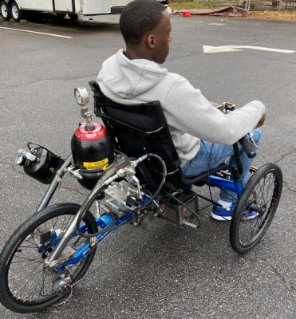
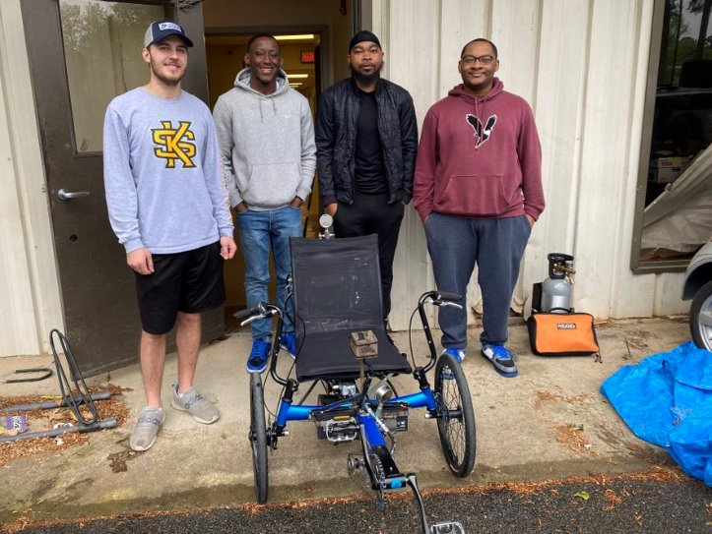
2022-2023 Overview
Last
Year’s
Vehicle

Slide 5
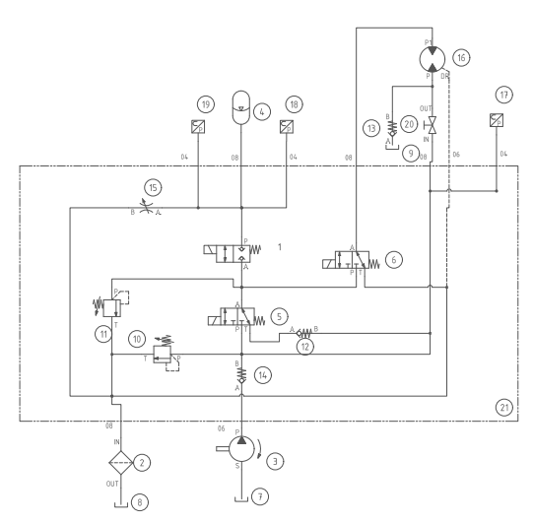
Final Hydraulic Circuit
Current
Vehicle
Fail safe to direct drive
Added filter to eliminate contaminants
Changed ball valve to eliminate leakage
2-way valve before accumulator benefits
Only transducers to improve electronics
2024 Hydraulic Circuit

Slide 6
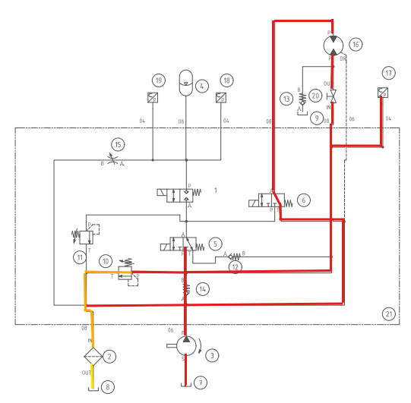
Direct Drive
Color | Scheme
Red | Working Fluid
Orange | Pressure Reduction
Yellow | Flow slowing down
2024 Hydraulic Circuit: Direct Drive Mode

Slide 7
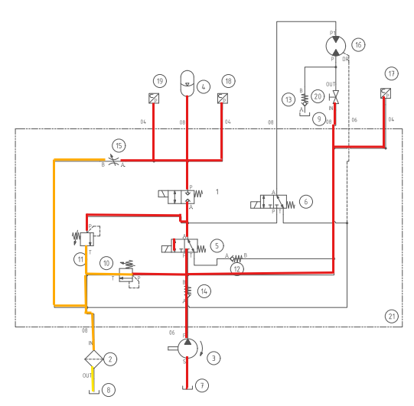
Direct Charge
Color | Scheme
Red | Working Fluid
Orange | Pressure Reduction
Yellow | Flow slowing down
2024 Hydraulic Circuit: Direct Charge Mode

Slide 8
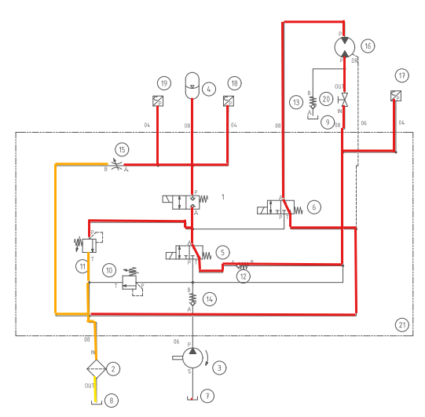
Accumulator Drive
Color | Scheme
Red | Working Fluid
Orange | Pressure Reduction
Yellow | Flow slowing down
2024 Hydraulic Circuit: Accumulator Drive Mode

Slide 9
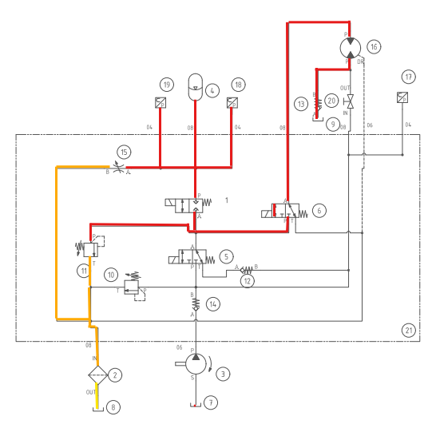
Regenerative Braking
Color | Scheme
Red | Working Fluid
Orange | Pressure Reduction
Yellow | Flow slowing down
2024 Hydraulic Circuit: Regenerative Braking Mode

Slide 10
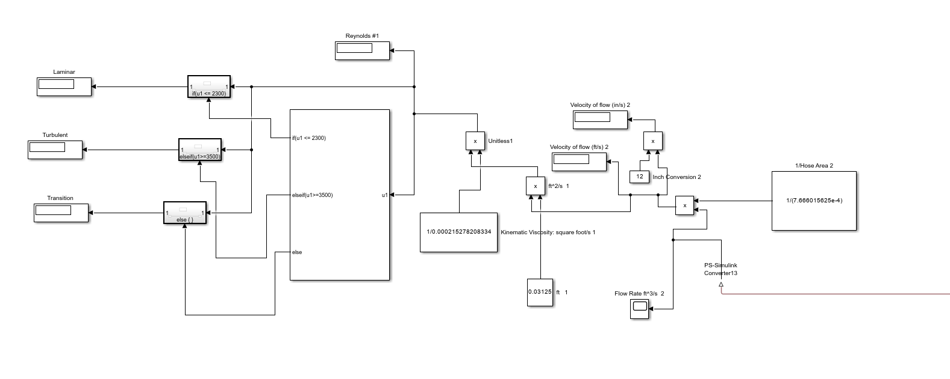
MATLAB Simulink Model

Slide 11
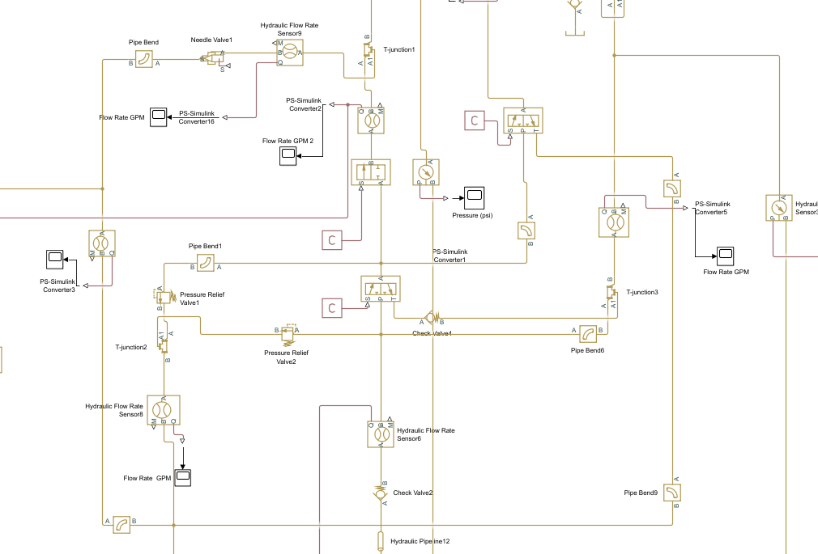
MATLAB Simulink Model

Slide 12
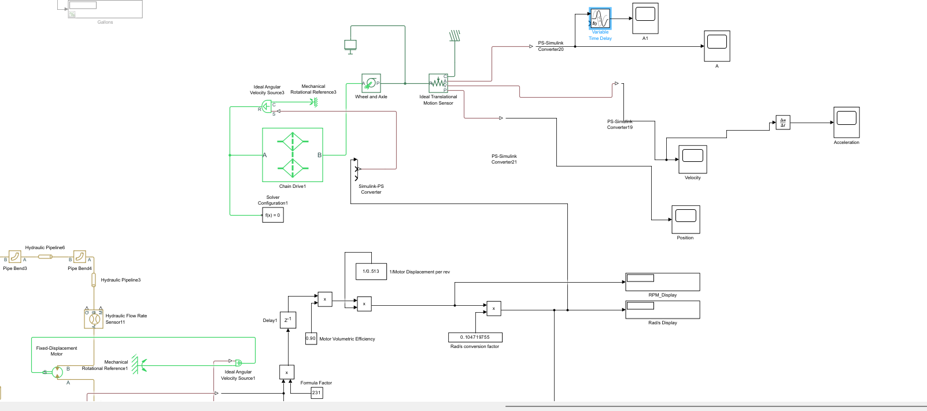
MATLAB Simulink Model

Slide 13
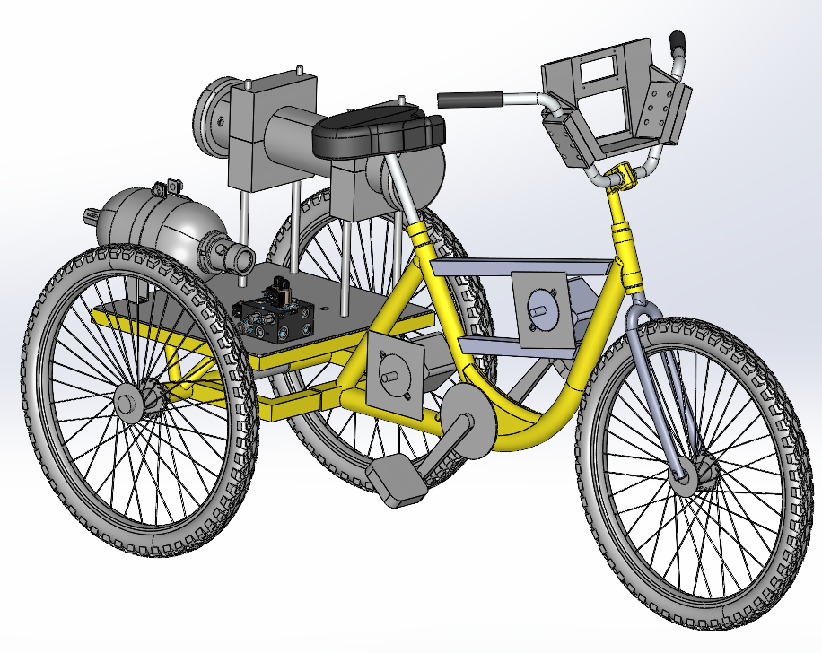
CAD
Model of frame based on exact dimensions
Full assembly used to estimate clearances and fitments
Computer aided engineering (CAE) simulations ran on mounts added to vehicle

Slide 14
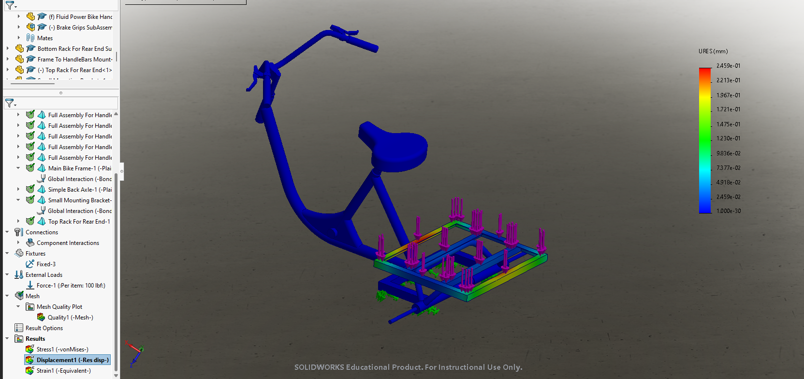
CAE – Frame
Plain Carbon Steel

Slide 15
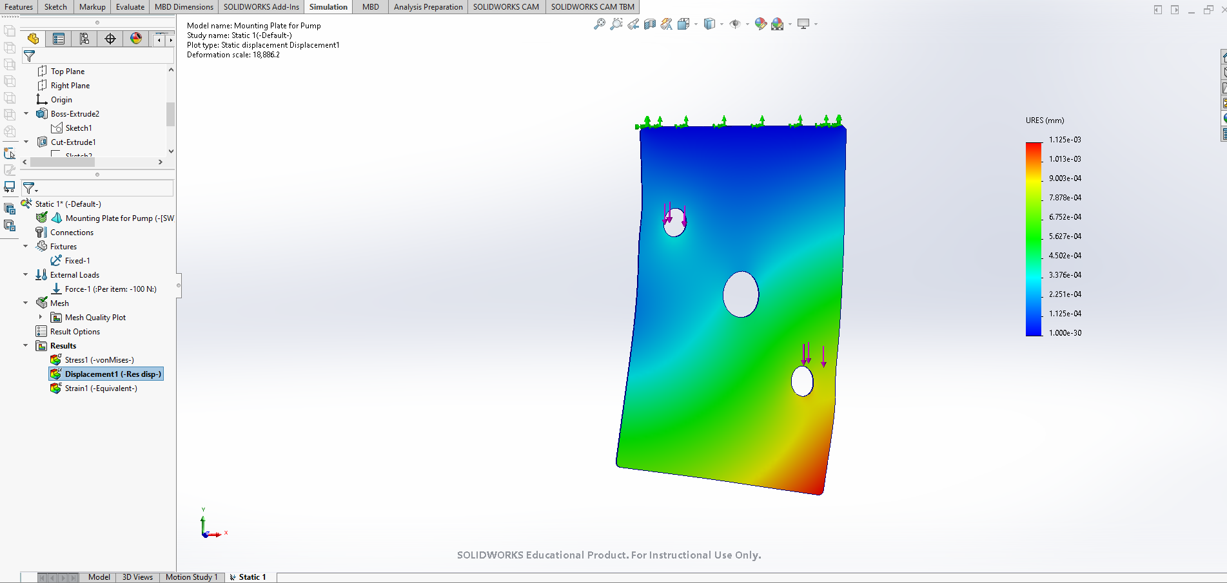
CAE – Pump Mount
Pump Mounting Plate with 100 N force on bolt holes.

Slide 16
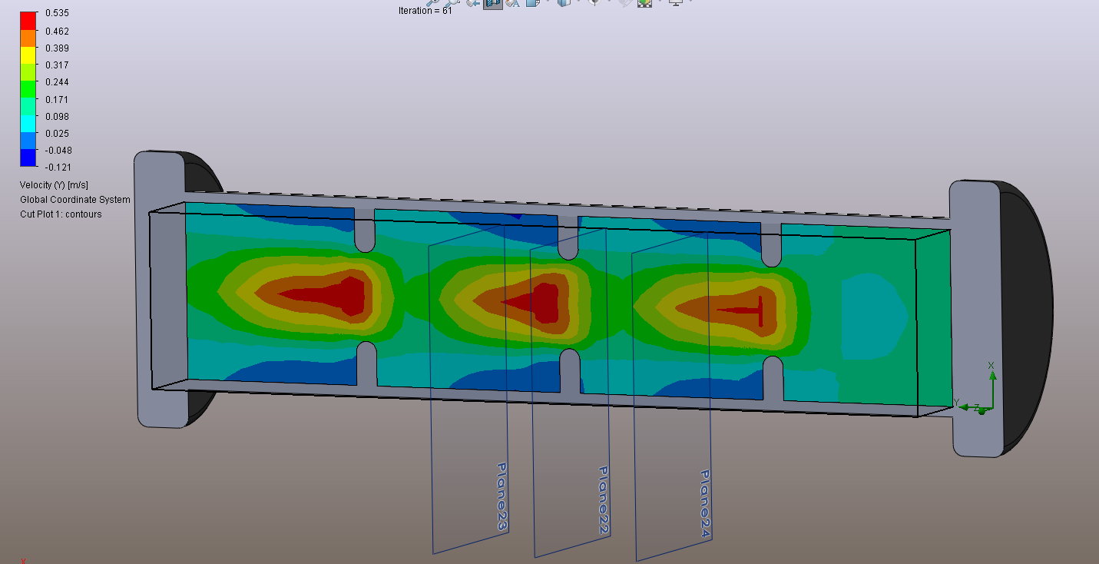
CAE – Reservoir Internal Flow
SolidWorks Simulation

Slide 17
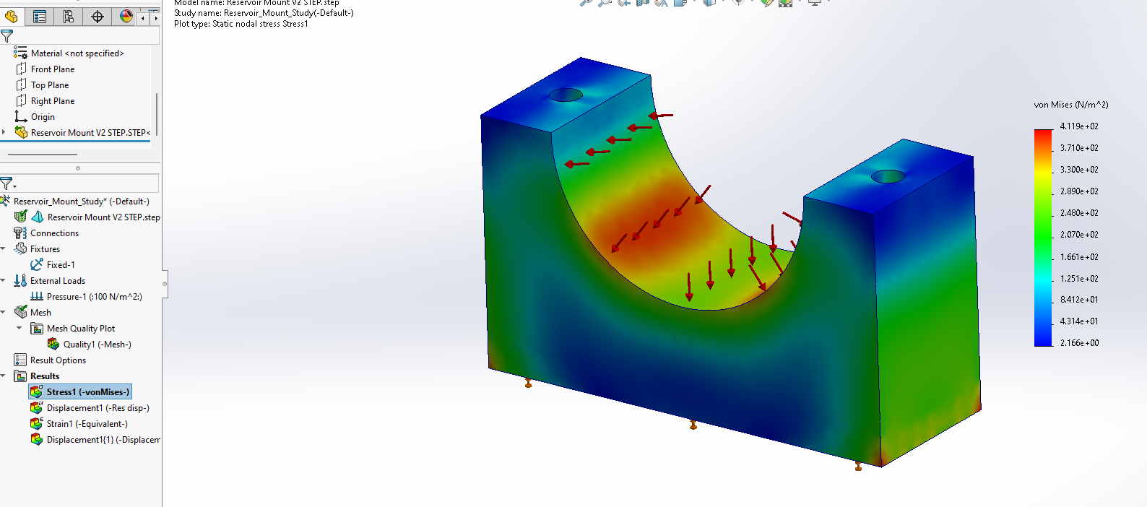
CAE – Reservoir Mounting
ABS

Slide 18
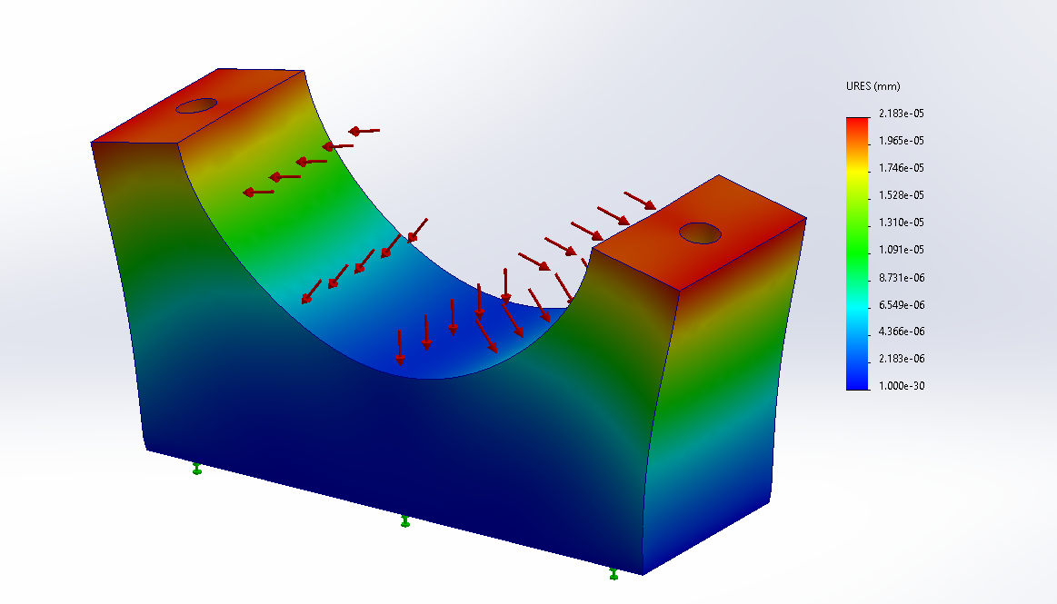
CAE – Reservoir Mounting

Slide 19
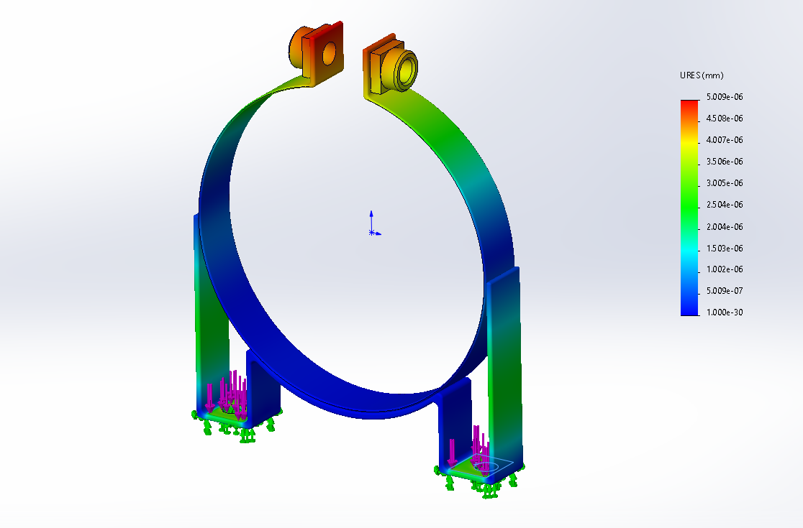
CAE – Accumulator Mounting
Galvanized Steel

Slide 20
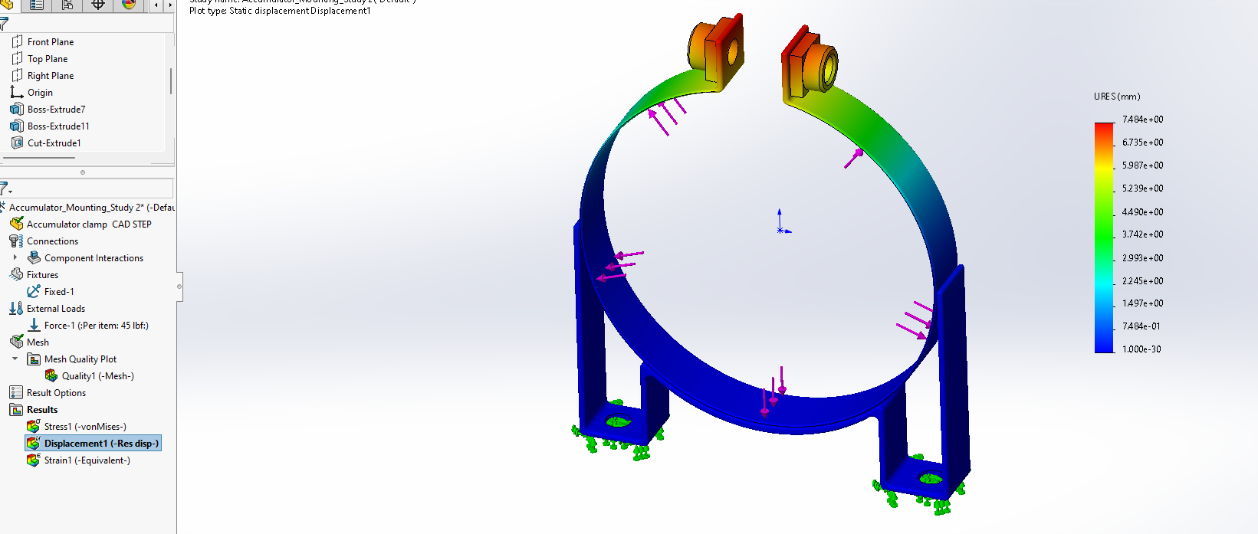
CAE – Accumulator Mounting

Slide 21
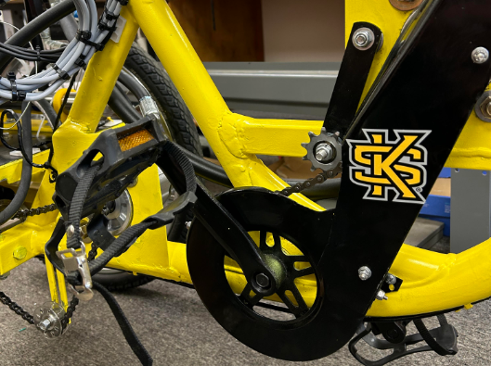
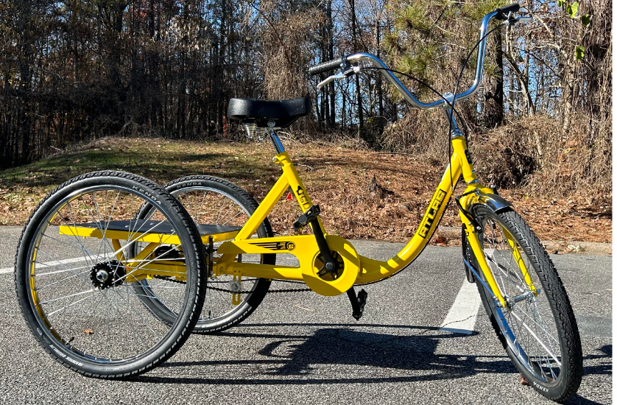
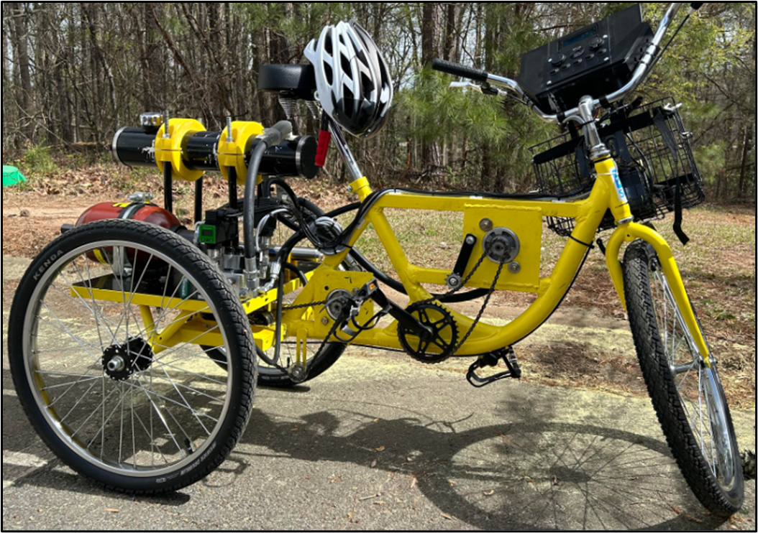
Vehicle Construction
Frame Modifications
  Steel back plate
  Steel bars and plates for motor and pump mounting
  Front basket for battery housing
  Elevated reservoir housing
Completed Chainguards
Initial Frame
Final Frame (Minus Chainguards)

Slide 22
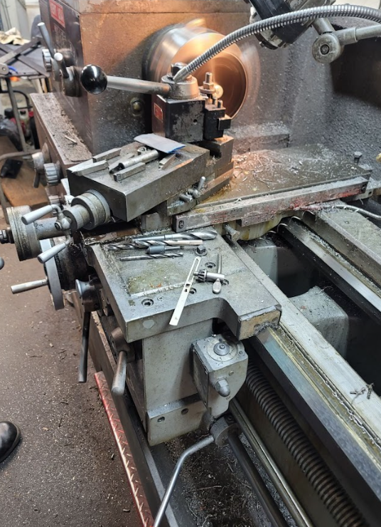
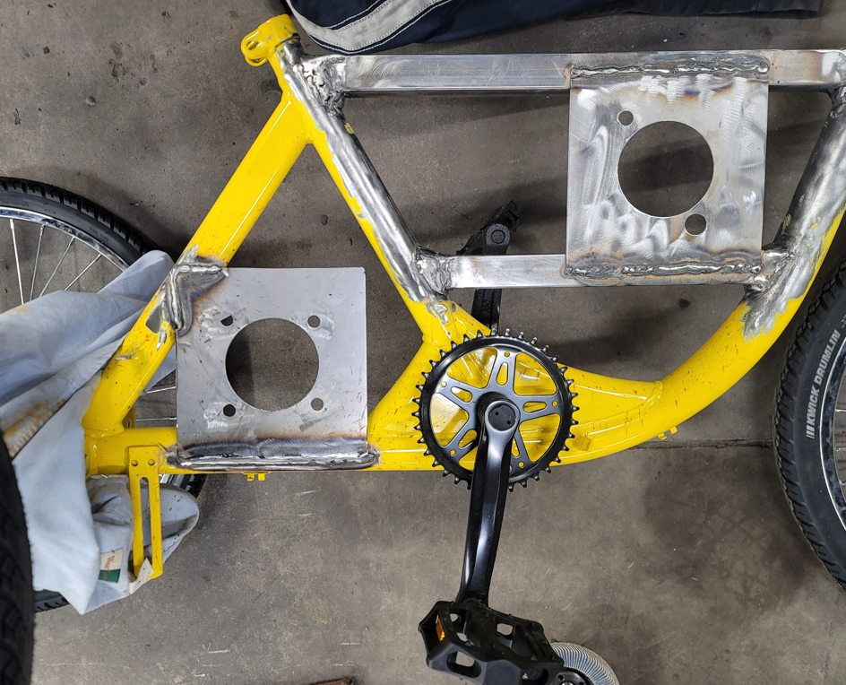
Vehicle Construction

Slide 23
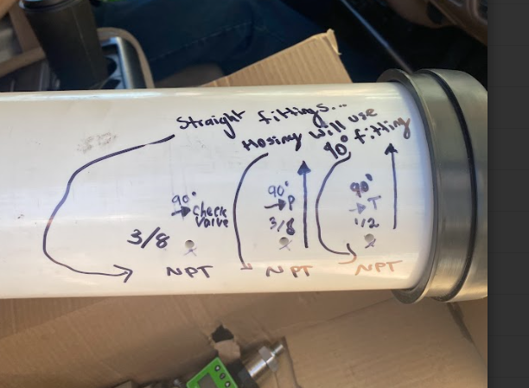
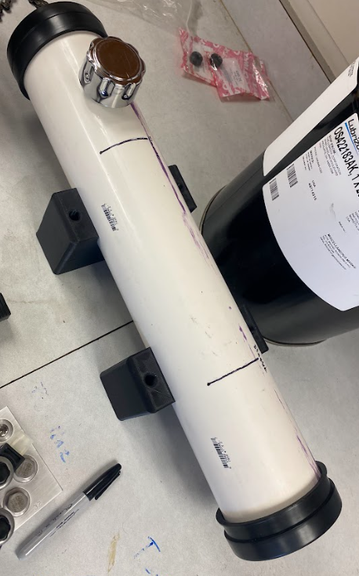
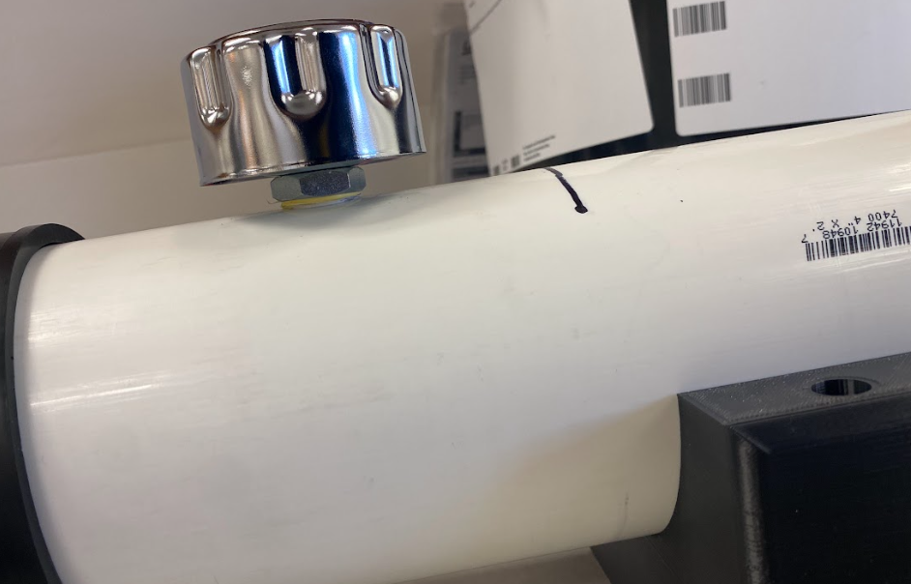
Vehicle Construction
Reservoir
  Custom made using PVC pipe
  Installed 3d printed baffles to reduce sloshing
  1 gallon capacity of fluid
  Lightweight and easy install

Slide 24
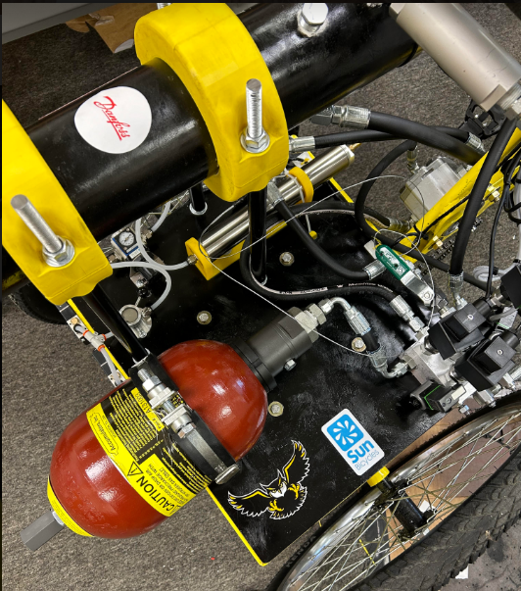
Vehicle Construction
Attaching equipment
  Manifold, Reservoir, and Accumulator to rear plate.
  Motor and Pump attached to custom welded plates and spaced correctly for chain alignment.
  Electrical and Pneumatic Equipment installed.
Hydraulic and Pneumatic Components on Back Plate

Slide 25
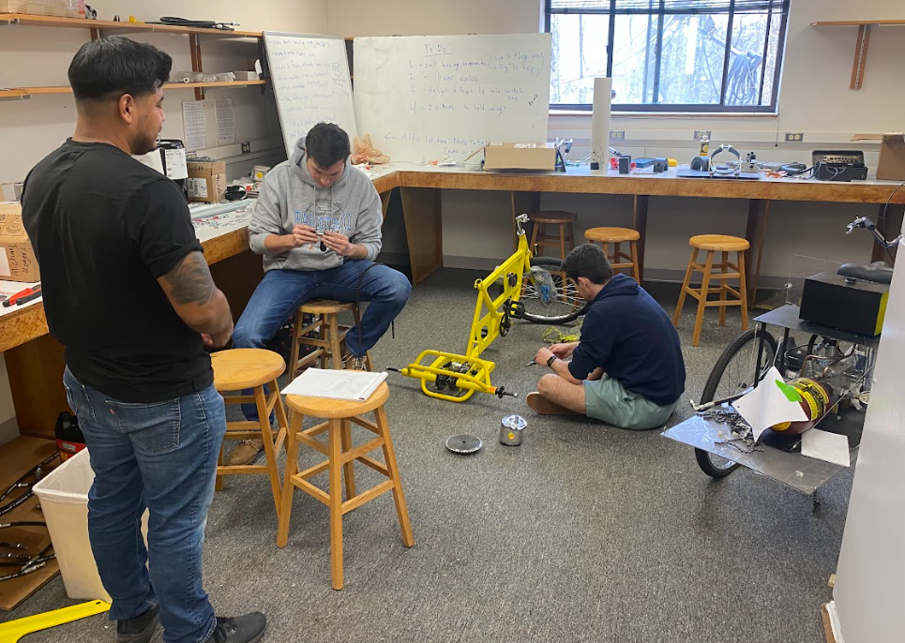
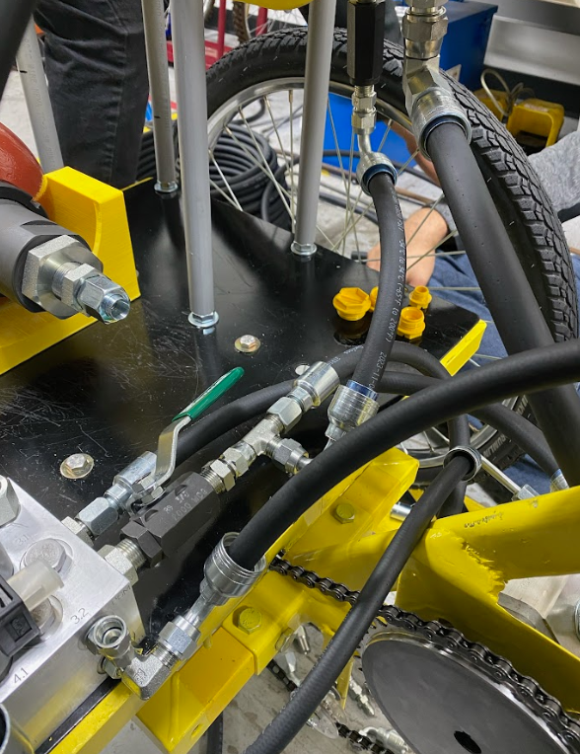
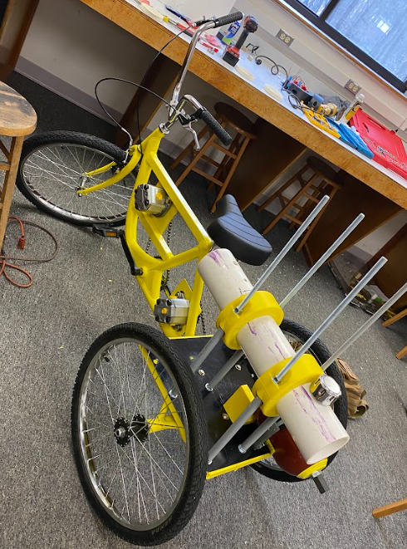
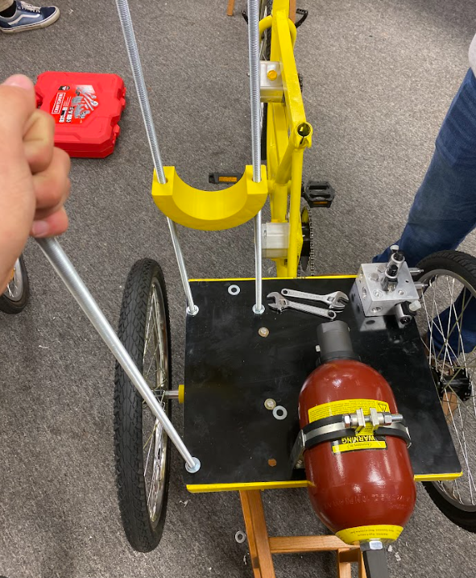
Vehicle Construction

Slide 26
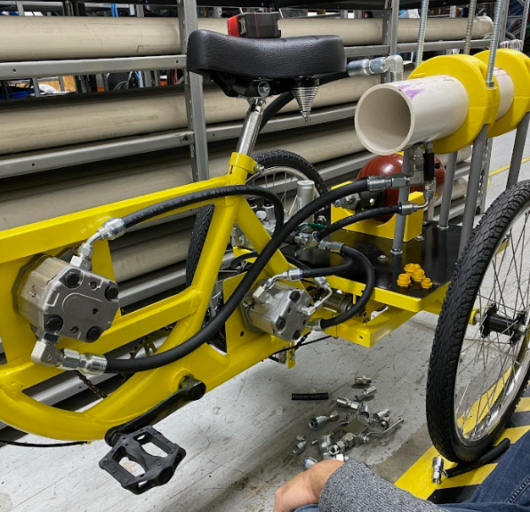
Vehicle Construction
Hosing Details
  Hosing was provided by the Hydraulic Supply Co.
  Provided us with the necessary hose lengths and fittings
  The team made necessary adjustments when we tightened the hosing

Slide 27
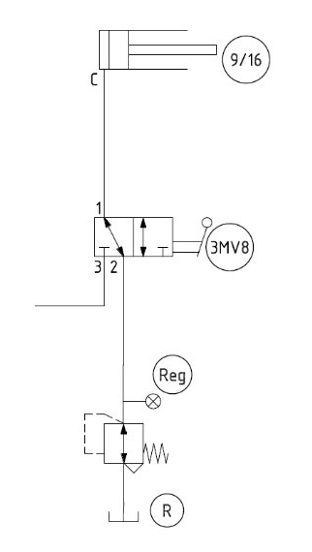
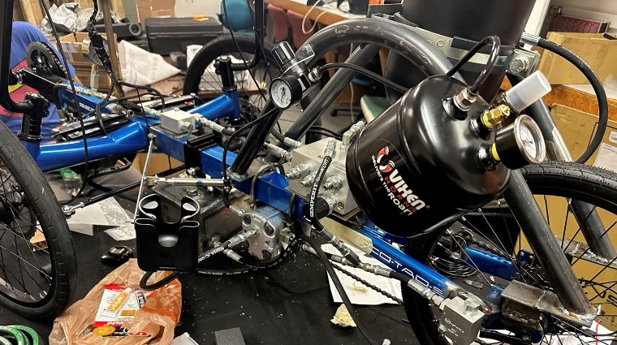
Pneumatic Design
Last
Year’s
Vehicle
Last year’s 2023 pneumatic design
Used pneumatics for cup and phone holder
2023 Pneumatics on Vehicle
2023 Pneumatic Schematic

Slide 28
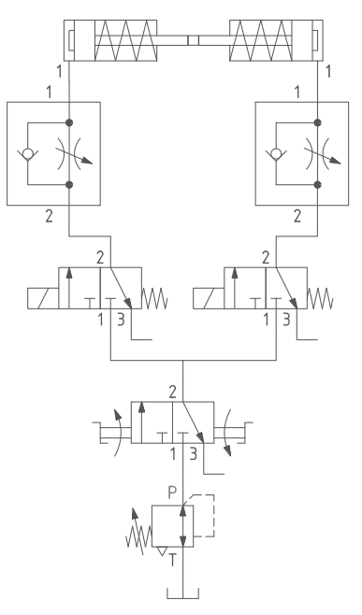
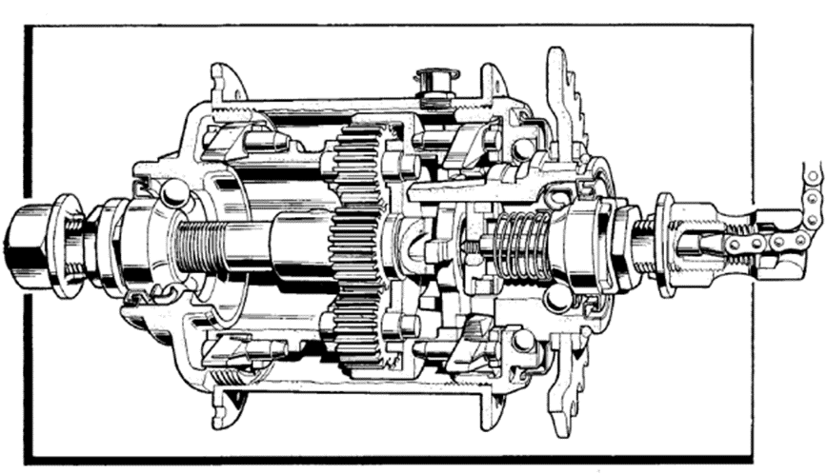
Pneumatic Design
Current
Vehicle
This year’s 2024 pneumatic design
Pneumatics used for gear shifting on vehicle
Changed method of manipulating gears (Using internal gear hub instead of typical sprocket set)
2024 Pneumatic Schematic
Internal Gear Hub Schematic

Slide 29
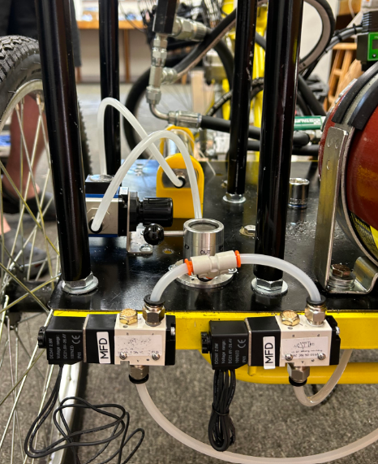
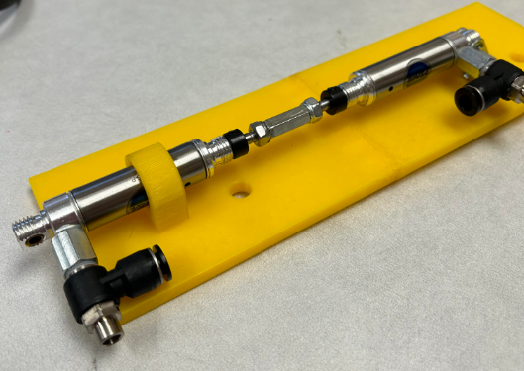
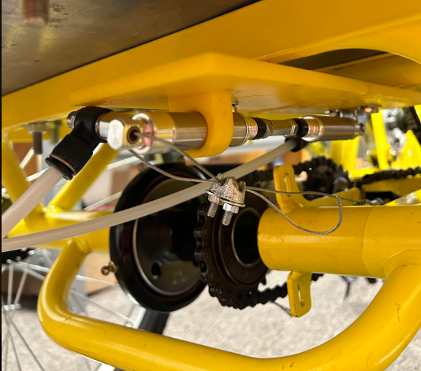
Pneumatic Design
Cylinder Assembly and Mount
Pneumatic Components
Cylinder Assembly Installed

Slide 30
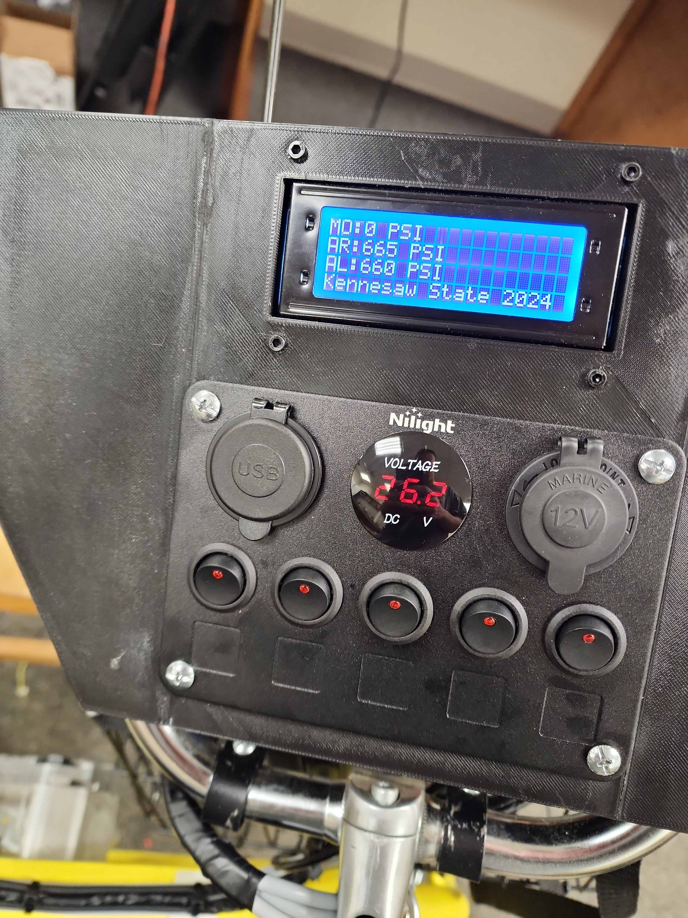
Electrical System
User-controlled drive modes using switch panels
Heads-up LCD displays pressure transducer readings
5-gang switch panel
  Customizable & accessible
  3 solenoid valves
  2 pneumatic actuators
Notes:
What are you doing differently this year to avoid last year’s battery failure? Electrical defaults to direct drive (lesson from 2023 vehicle)

Slide 31
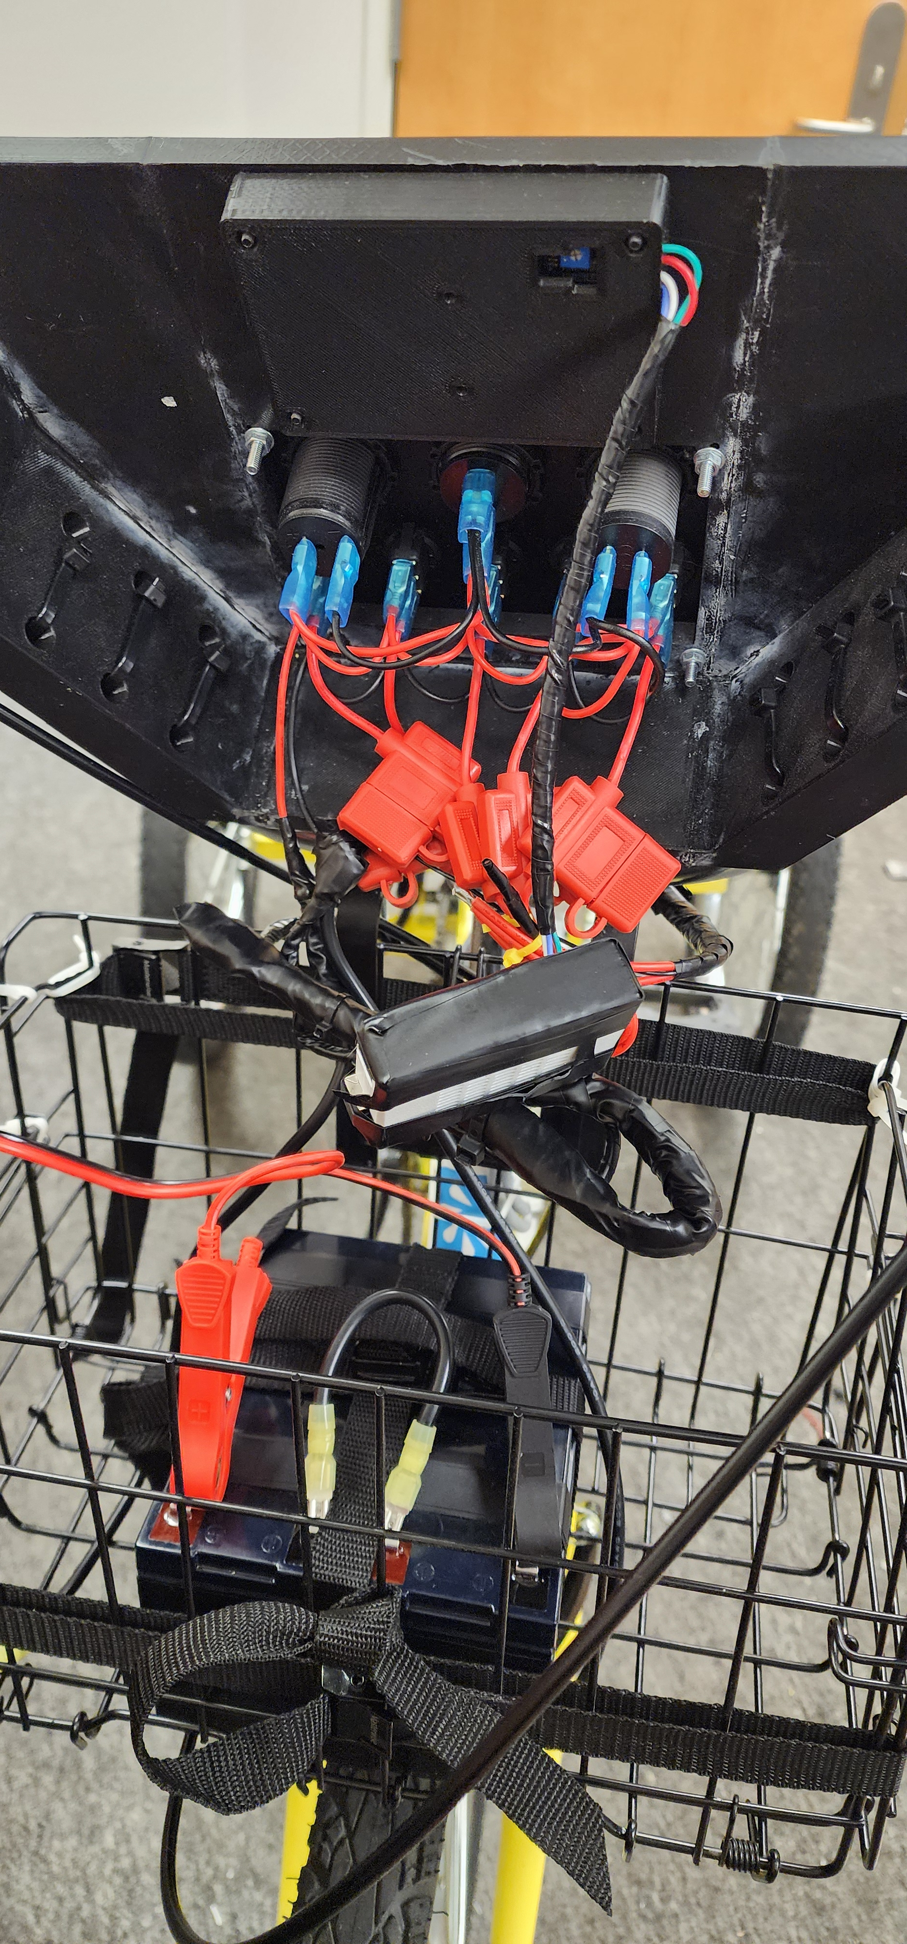
Electrical System
24V source created with two 12V deep cycle batteries in series
  Industry standard sensor voltage
  Price
  Weight
System defaults to direct drive in the event of a failure
  De-energized solenoid valves
  2023 lesson
Notes:
What are you doing differently this year to avoid last year’s battery failure? Electrical defaults to direct drive (lesson from 2023 vehicle)

Slide 32
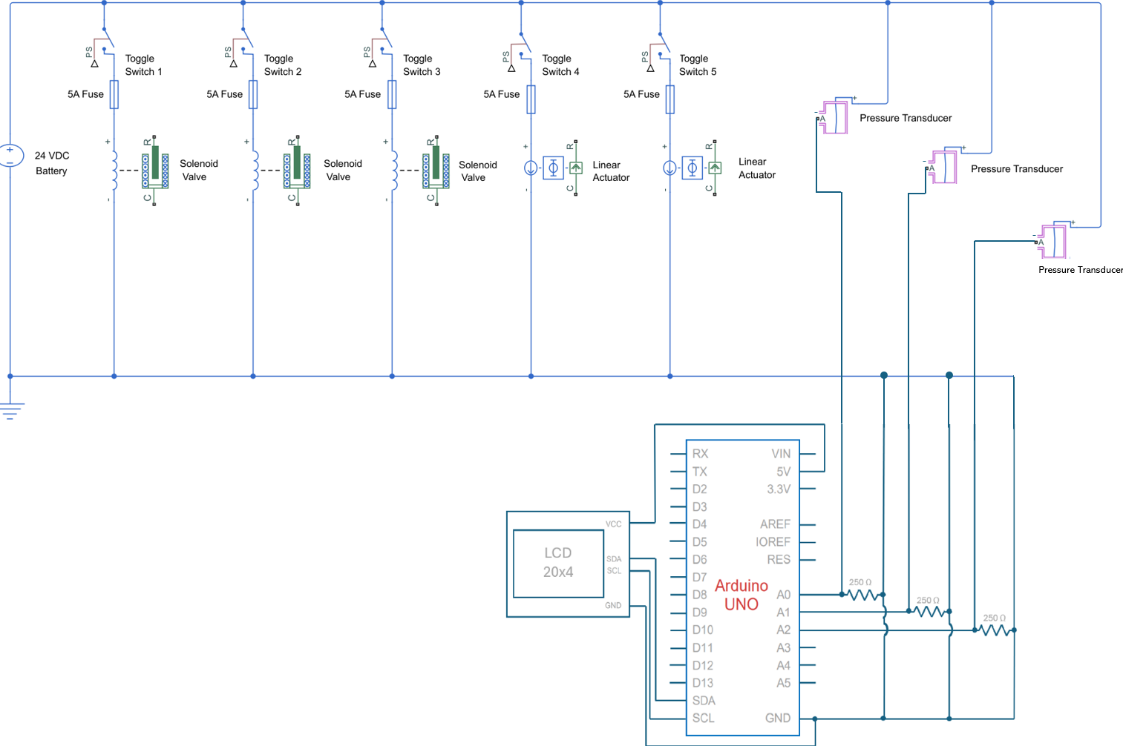
Safety
Fused components
Resistors for microcontroller
Soldered connections
User-friendly cable management
Digital Voltmeter
Battery maintainer
Battery proximity to hydraulics
Notes:
What are you doing differently this year to avoid last year’s battery failure? Electrical defaults to direct drive (lesson from 2023 vehicle)

Slide 33
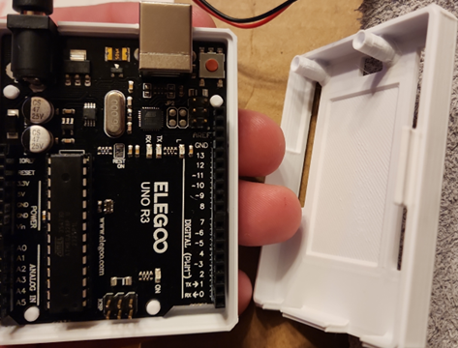
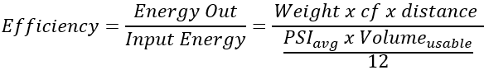
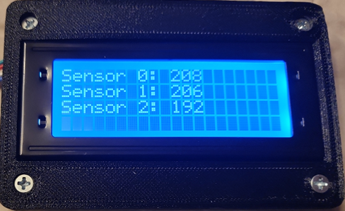
Electrical System
Arduino UNO R3 Micro-controller with LCD display
  Lightweight
  Adjustable Arduino IDE code
  Efficiency calculation optimized
  Controller & LCD Weight [0.27 lbs.]
HMI considered
  Heavier weight
  Excessive power consumption

Slide 34
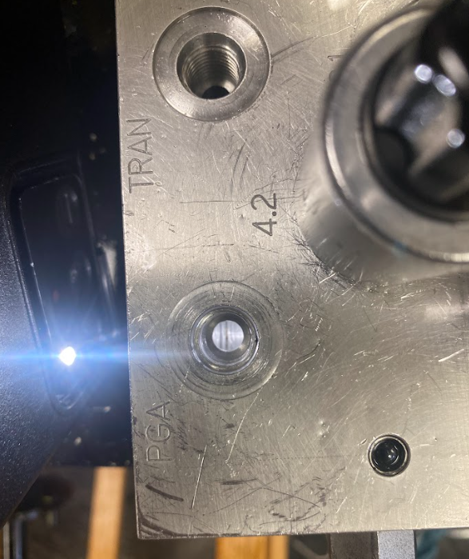
Vehicle Testing
Continuous testing for 21 days
Changed gearing ratio for greater focus on torque instead of speed
Discovered the manifold was not machined correctly
Conclusion: variety of factors prevented initial functionality
  PRVS, gear ratio, etc.

Slide 35
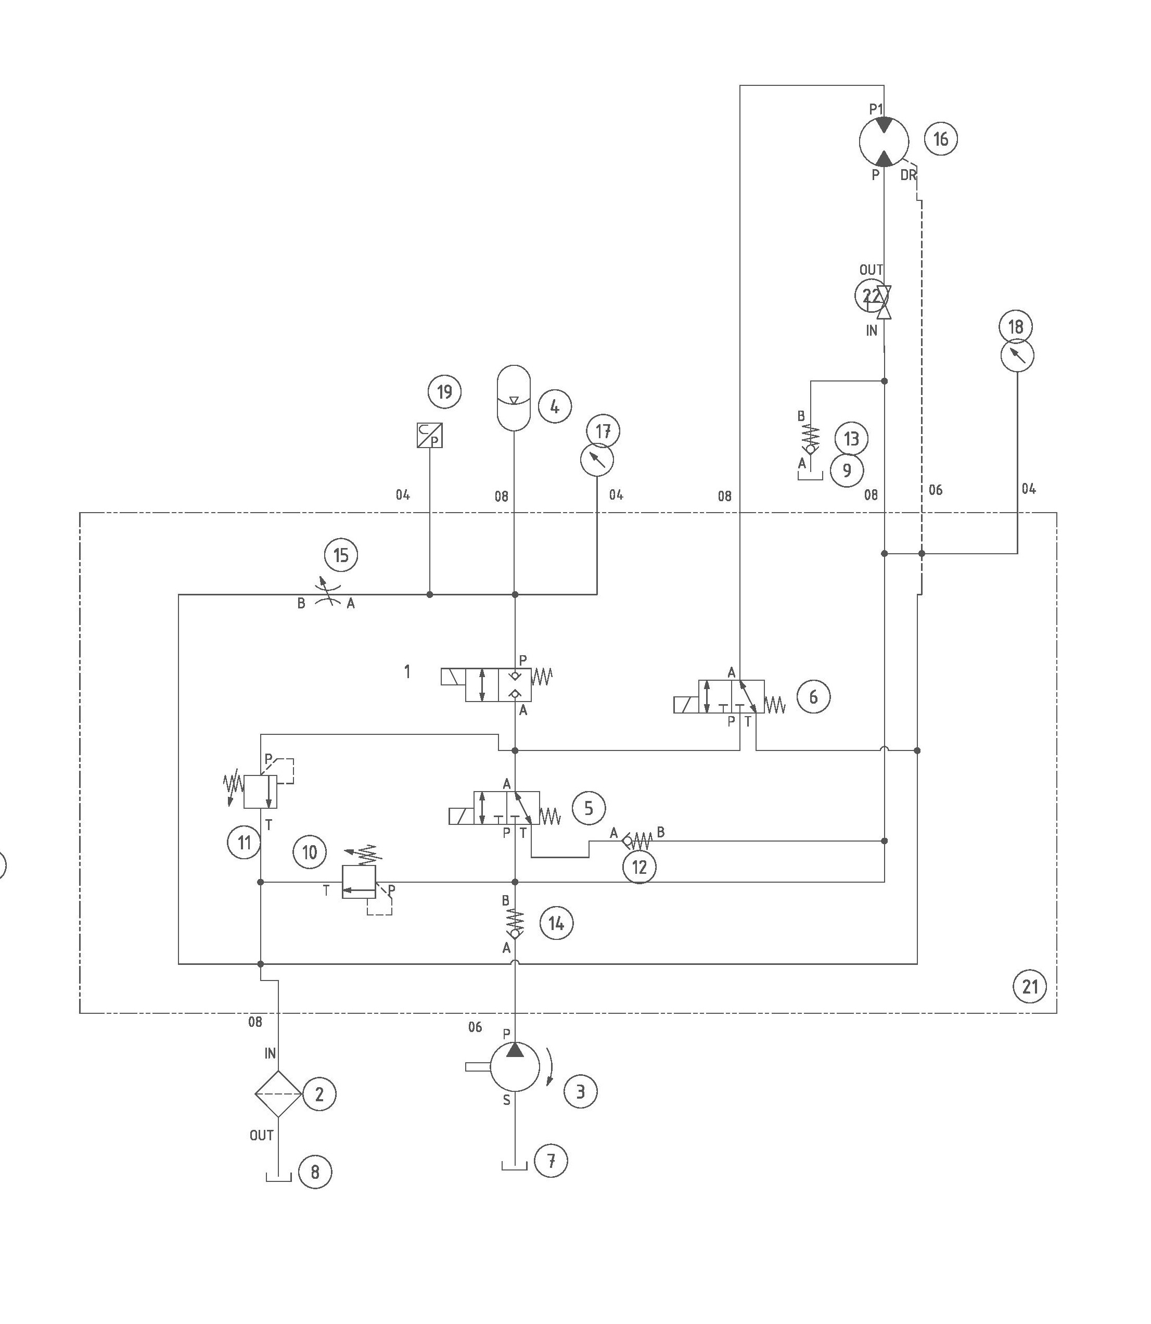
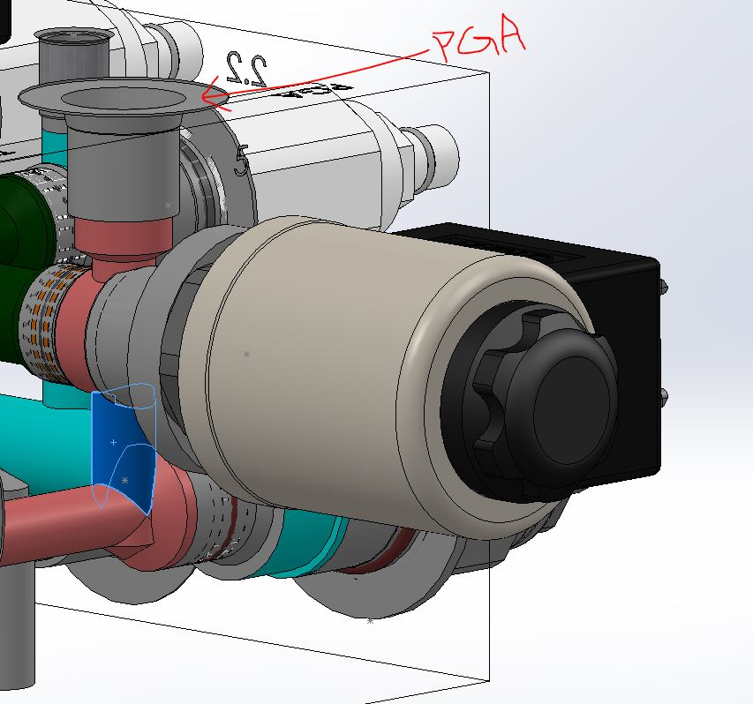

Vehicle Testing
Manifold CNC files showed there was a connection that was not drilled.
Need image of CNC file here
Manifold Connection Missing

Slide 36


Vehicle Testing
Manifold Sideview
Manifold Rearview

Slide 37


Vehicle Testing
The motor used through initial testing leaked due to a failure in the shaft seal
Hydraulic Motor
Motor shaft seal

Slide 38

Calculations
Spring 2024
Final Gear Ratios:
Pump-
36/9 ; 4/1 ratio
-greatly increasing rpm, increasing flow rate
Motor-
1. 9/20 : 20/24 ; .45/1 ; .83/1 ratios
2. 9/24 ; .375/1 ratio
- focused on increasing torque on the rear axel

Slide 39

Lessons Learned
Ask questions early
Reach out to the local hydraulic shops
Gear the motor ratio for torque instead of speed initially
Ensure designed flow path matches machined parts
Do not push your motor too hard when testing

Slide 40

Design Improvements
Fail safe to direct drive
Increased electronics complexity & functionality
Created functional pneumatics with increased complexity
Torque-driven gear ratios
Improved aesthetics
Fabrication completed weeks earlier to compensate for testing and optimization phase

Slide 41


Design Choices Matter!
Electronic choices conserved weight
Reservoir choices conserved weight
Pneumatic additions gave us torque and speed advantages
Fail safe system to direct drive ensures we can compete in case of electrical issues

Slide 42
Design Choices Matter!
Frame choice paid off
Use of industry standard roller chain sprockets allowed for quick access to sprockets of varying numbers of teeth

Slide 43

Club Success
Became a Registered Student Organization (RSO) at KSU in Fall 2023
Had a successful first club meeting (online) with our guest speaker, Ernie Parker (February 1st)
Had a successful in-person club meeting with Eric Cummings @ Ross Controls (February 23rd)
Had a successful in-person club meeting with Cory Fisher @ Sun Hydraulics (April 2nd )
Notes:
Don’t say anyone was better than anyone else say everyone was great!!

Slide 44

Acknowledgments
Cory Fisher, Sun Hydraulics
Ernie Parker, International Fluid Power Society
Jared Amundson, Norgren
Alex Greven, HYDAC
Will Peterson & Alex Pruitt Redwine, Hydraulic Supply Co
Mary Pluta, NFPA
Holly Davis, Office Manager KSU Mechanical Engr. Department

Slide 45


Questions?

