Slide 1
FINAL PRESENTATION Iowa State University
04/22/2024

Slide 2
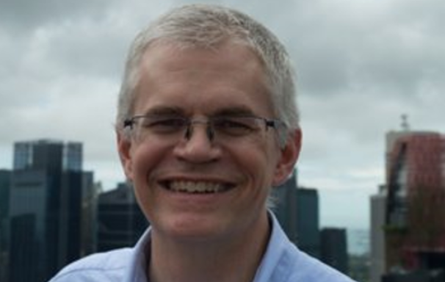
Team Introductions
Michael T - Branstad
Saul Huntley-Ayala
Jack Smith
Ashley Althaus
Austin Nolley
Dr. Brian Steward
Dr. Saxon Ryan

Slide 3
Overview
Vehicle Construction
Component Design
Final Vehicle
Hydraulic & Pneumatic Circuits
Bike Changes & Improvements
Electronic Controls & Instrumentation
Lessons Learned

Slide 4
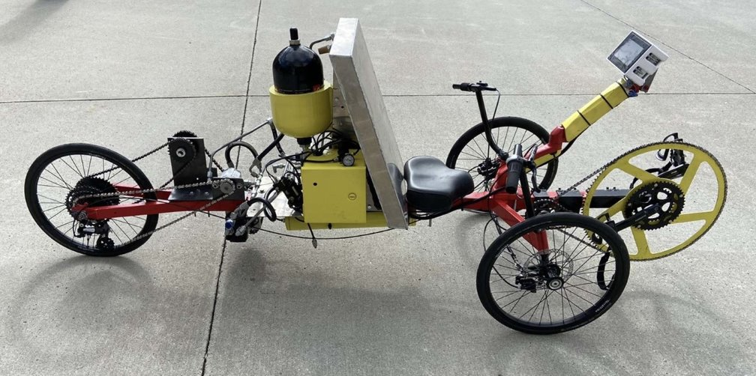
Failure Investigation
Last year we suspected one or more components failed during the competition.
Micro Pump, 2.8cc motor, reservoir design

Slide 5
Goals
Minimize Pressure Losses
Change size and orientation of solenoids
Maximize Direct Drive Efficiency
Resize human input pump
Replace the large chain reduction with a gear box for better packaging.
Finish on the Podium in the Competition
Finish first in efficiency test
Finish in top three in regen and sprint test

Slide 6
Design Choices
Design of new frame
Use extruded aluminum T-Slot channel framing | 80/20 brand
Enhanced rigidity where it was needed to maintain chain alignment
Redesign the fluid revisor and reintroduce a seat to the frame
Transfer several components from old frame to new frame
Design of New Circuit
Use of 4 2/2 normally closed DCV's in parallel
Increase available flow rate to reduce pressure drop
Design of New Gear Box
1:19.75 Gearbox ratio
1:82 Overall ratio

Slide 7
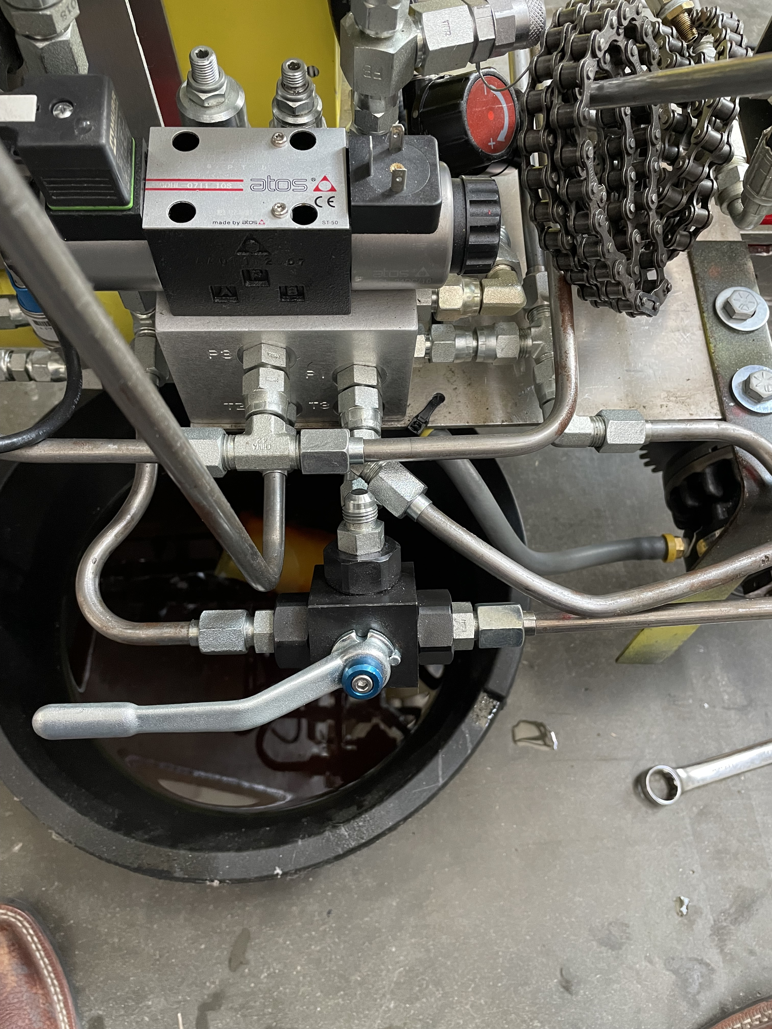
Testing
Disassembled 0.3cc/rev micro pump
Tested micro pump with the old reservoir
Straight lined directly connected to 2.8cc/rev motor

Slide 8
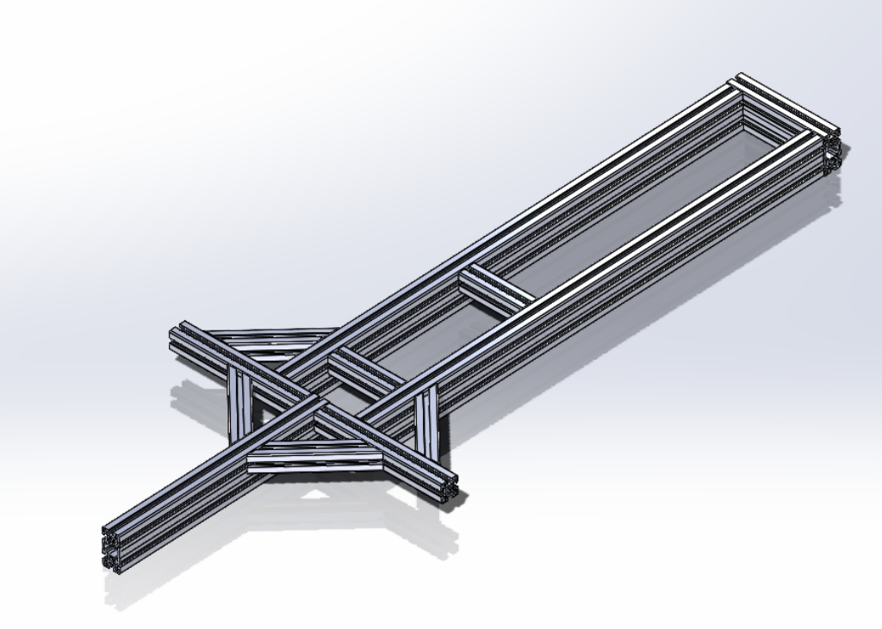
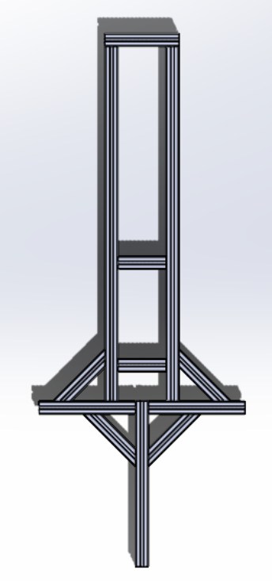
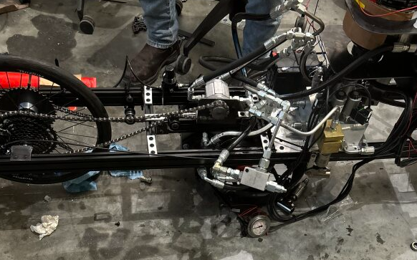
Vehicle Construction
New Frame Design
Construction in progress
Members made of 45x90 and 45x45 extruded aluminum
Makes for easy placement and chain alignment

Slide 9
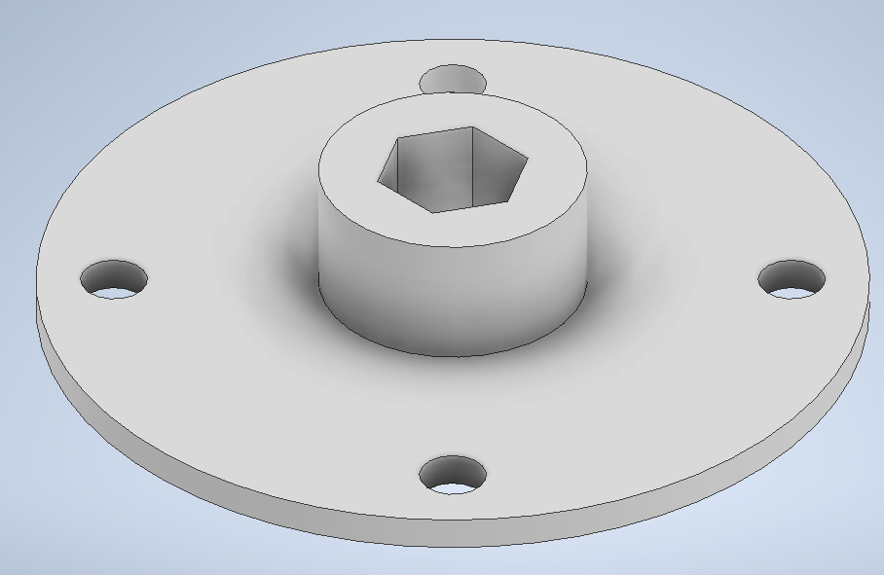
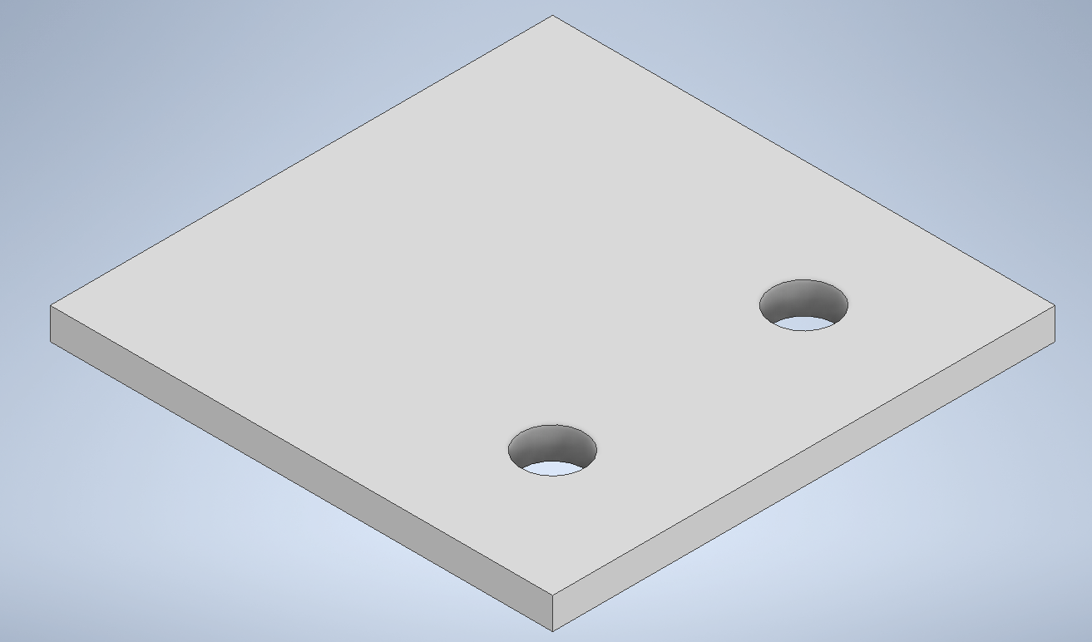
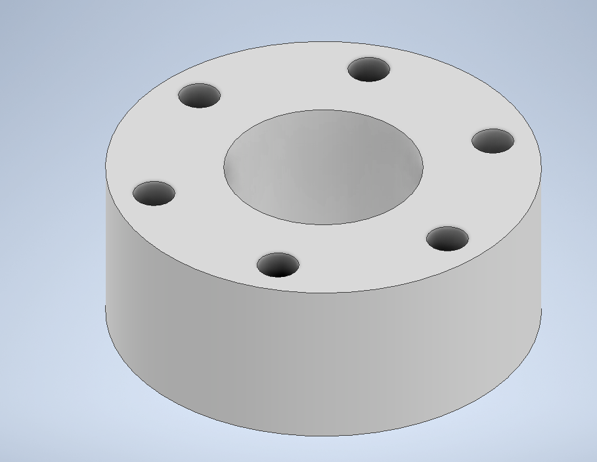
Designed Components
Bike Sprocket Adapter
80-20 Bracket
Back Tire Bracket
Axle Spacer

Slide 10
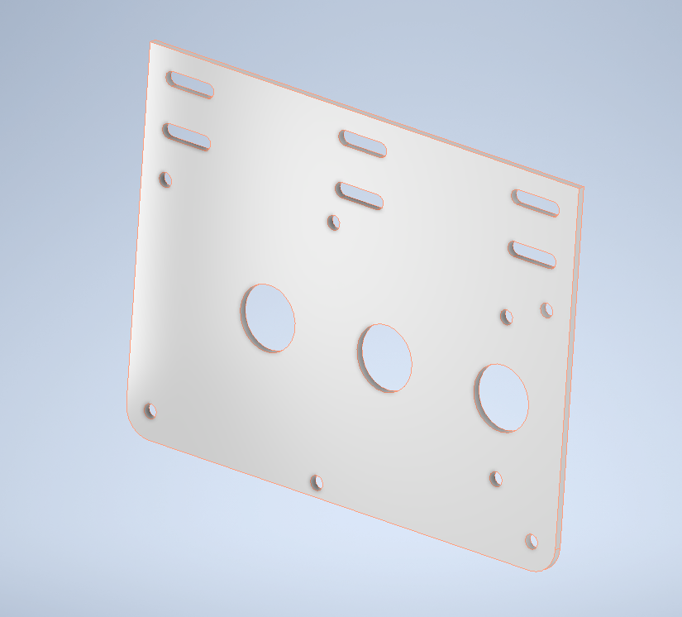
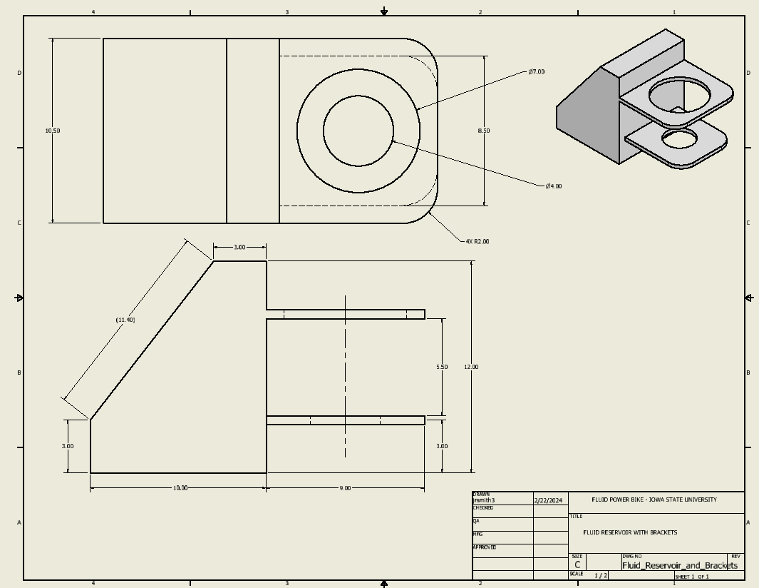
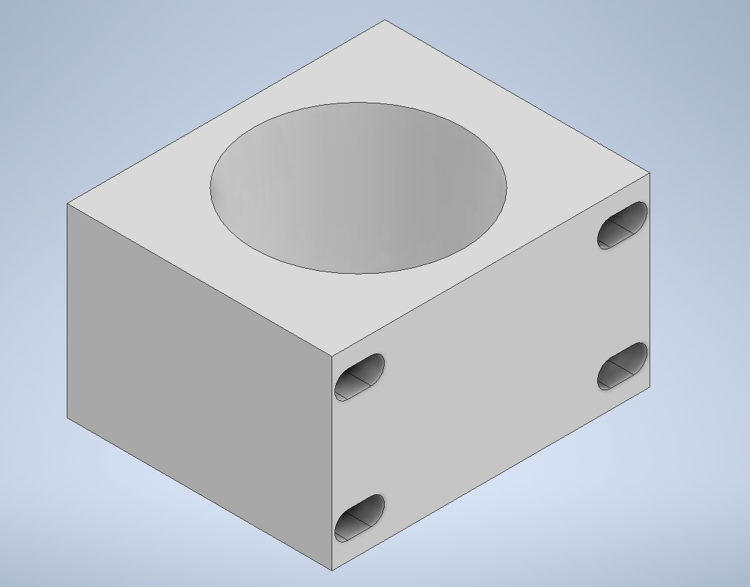
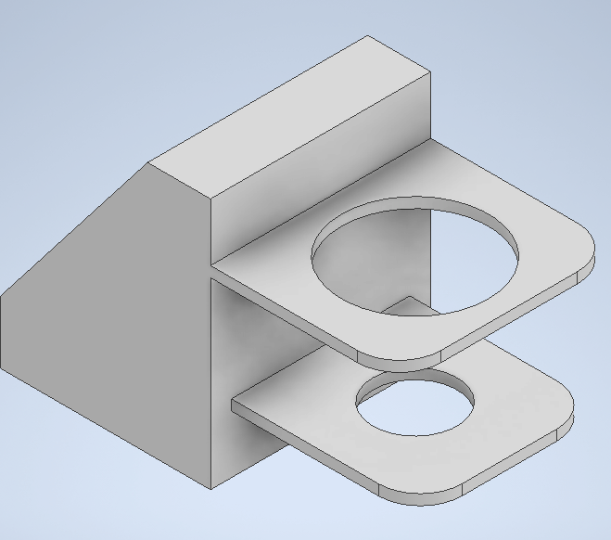
Designed Components
Gearbox – Final Side 1/8th" thick steel. Dimensions are 6.75 x 9 inches
Fluid Reservoir DWG
Pump Mount
Fluid Reservoir and Bracket.
(Initial thought)

Slide 11
Current Vehicle State

Slide 12
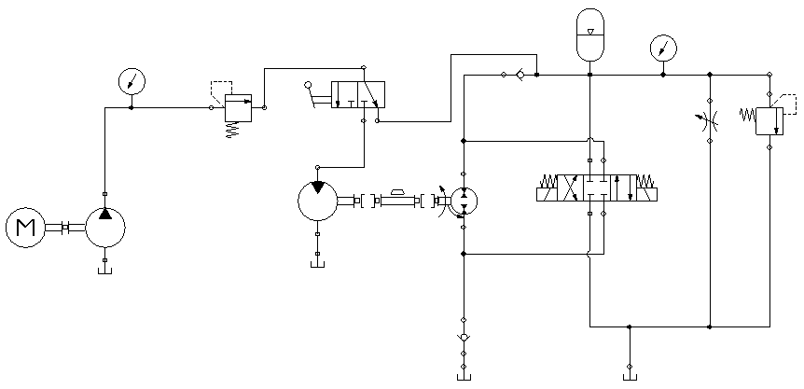
Previous Hydraulic Circuit

Slide 13
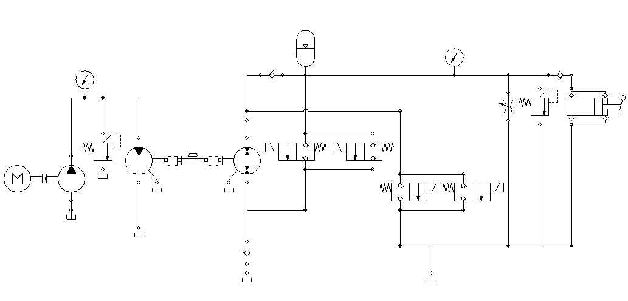
Current Hydraulic Circuit
Pedal Circuit
Accumulator and Regen Circuit
Improvements: One 4/3 DVC replaced with 4 2/2 DCV in parallel
Manual valve taken out of circuit
Added hand pump

Slide 14
Pedal Power

Slide 15
Accumulator Pressurization

Slide 16
Accumulator Power

Slide 17
Regen Power

Slide 18
Pneumatic Circuit

Slide 19
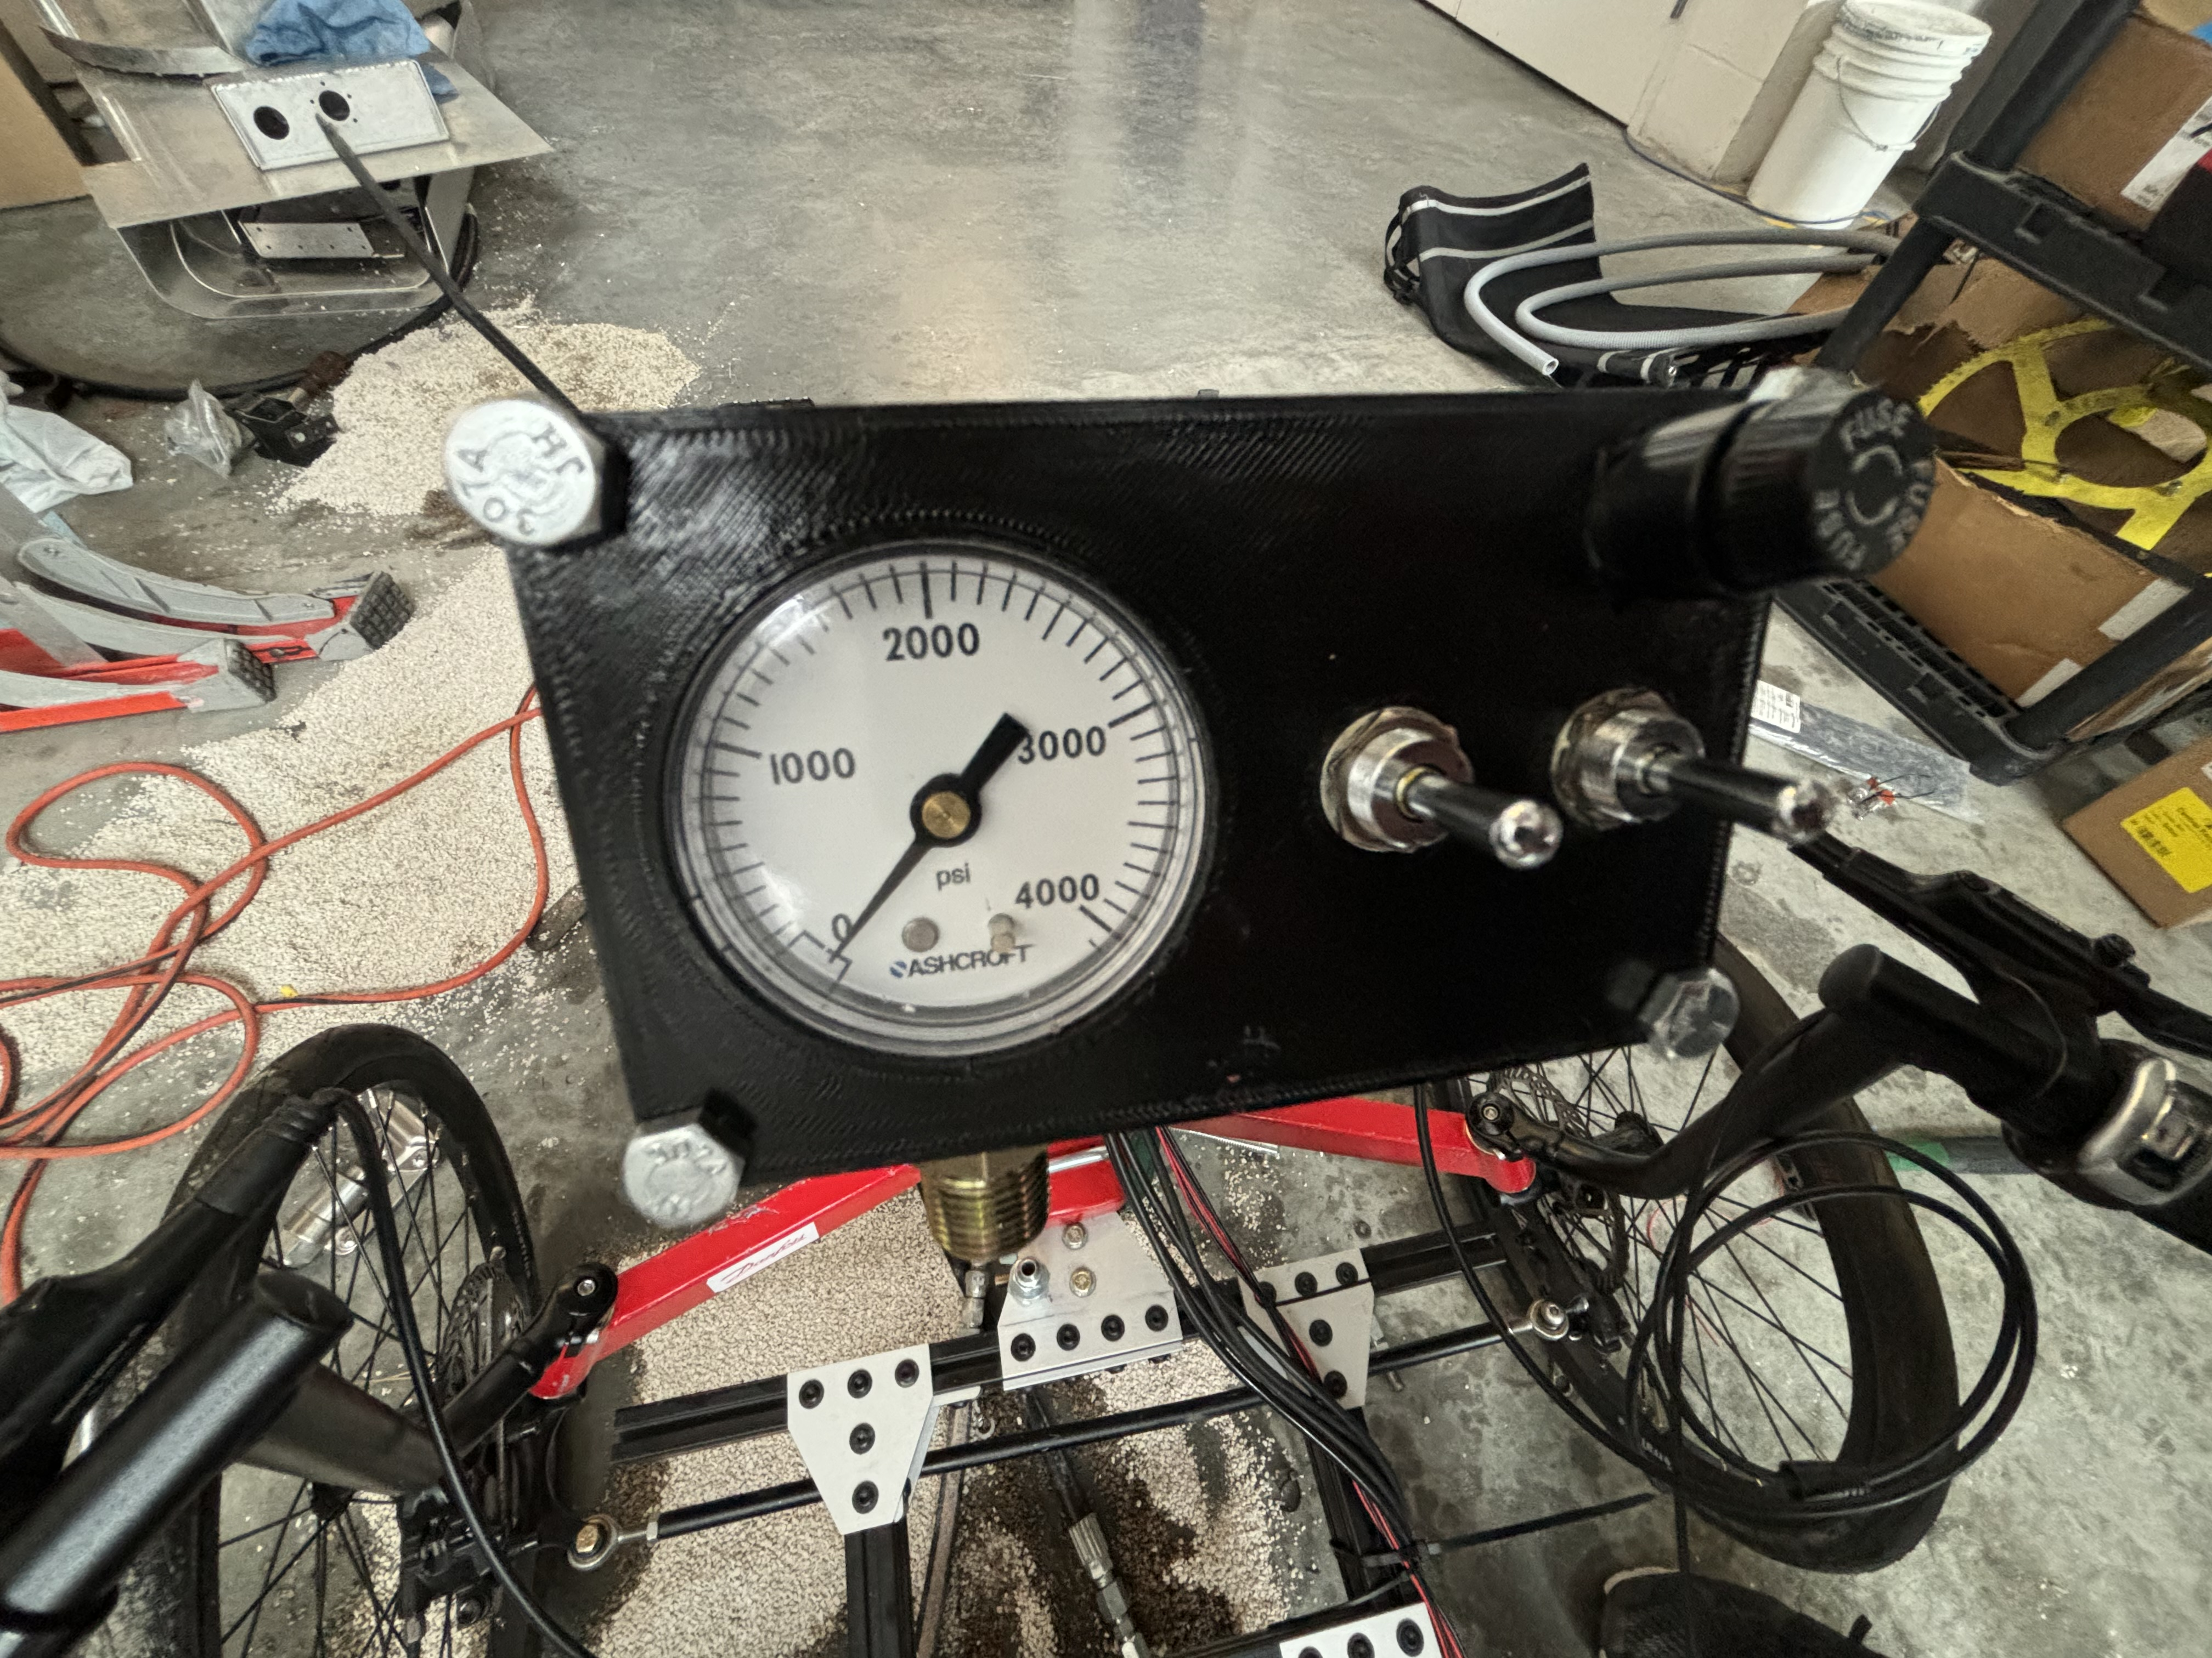
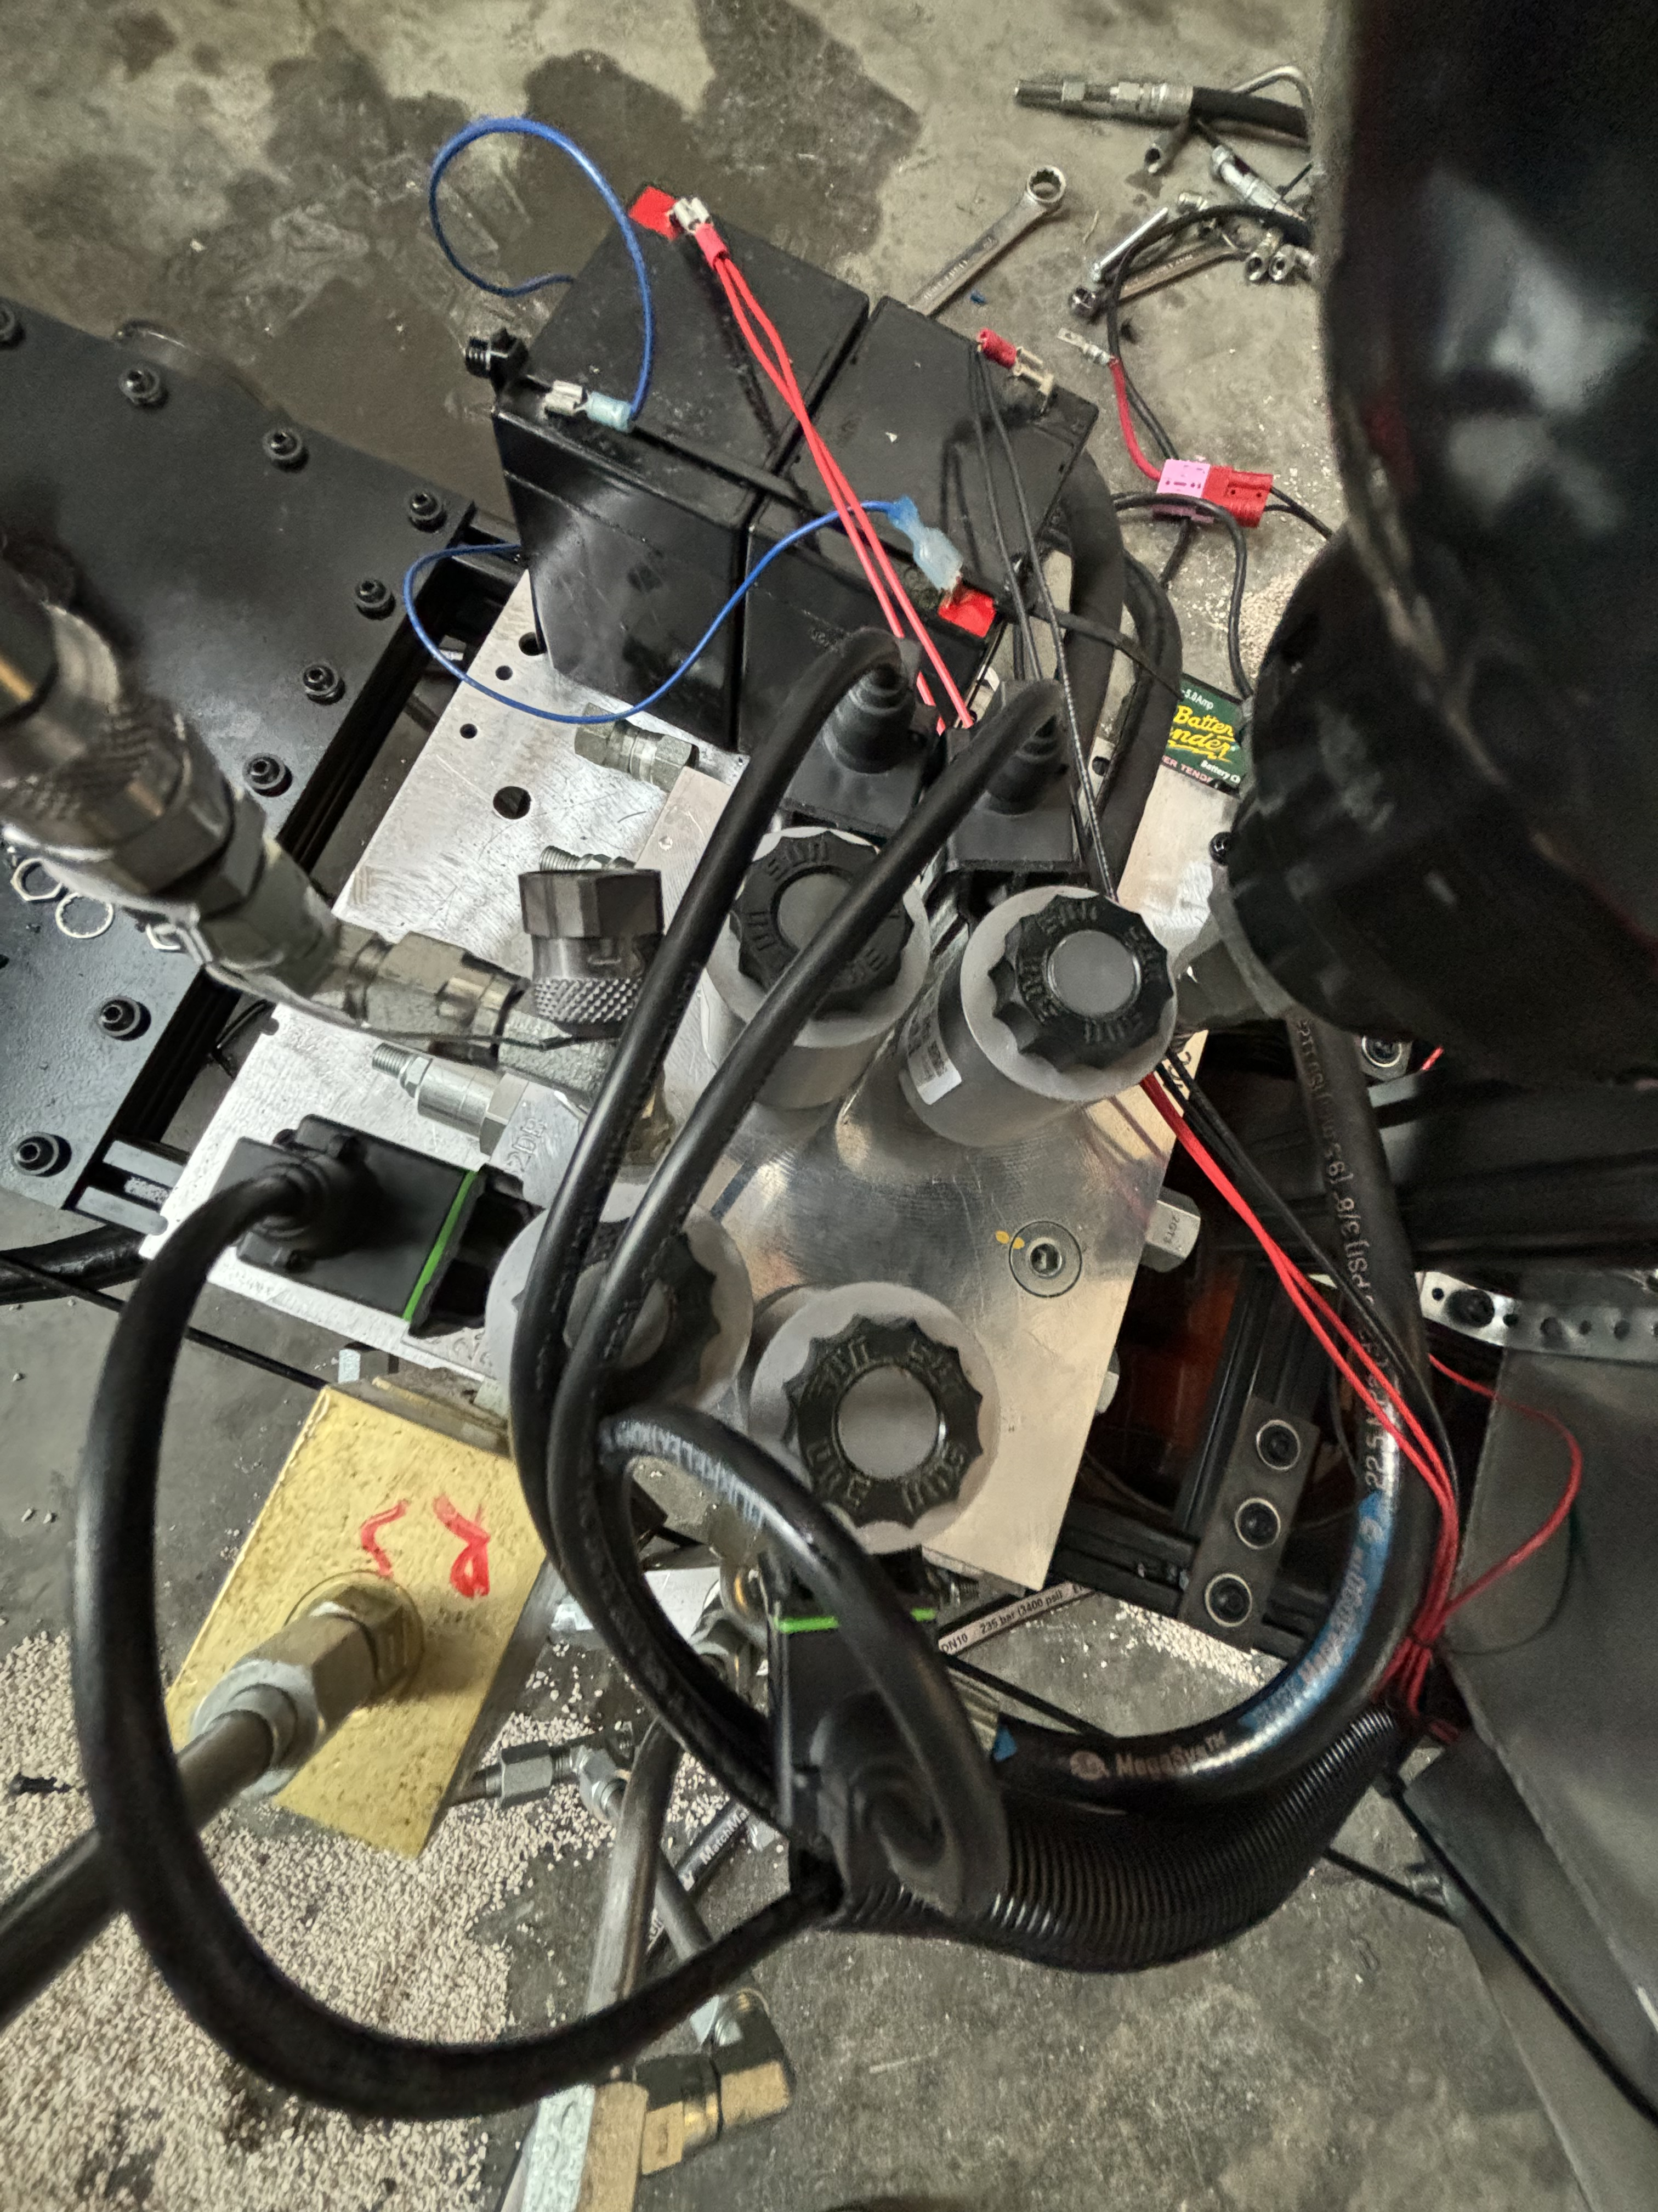
Electronics
2 – 12-volt interstate batteries (total 24 volt) powering four solenoids above the manifold connected by switches in the front of the bike.
Our original plan was to utilize the controller from previous team designs but have faced issues with software and time constraints. The use of the switches achieved the same goal with a simpler approach.

Slide 20
Hardware Selection

Slide 21
Lessons Learned
Long lead times for components
Chain alignment and hardware must be precise
Utilize knowledge of industry professionals
Establishing mentors
Fostering relationships
Setting deadlines is essential
Planned worktimes and meetings
Communication with group members and mentors is important

Slide 22
Thank you!

